Slide 1
Immune cell subsets associated with immune-related adverse events during checkpoint inhibitor therapy
2-27-2025
Ty Bottorff – Bioinformatics postdoc
Linsley lab

Slide 2
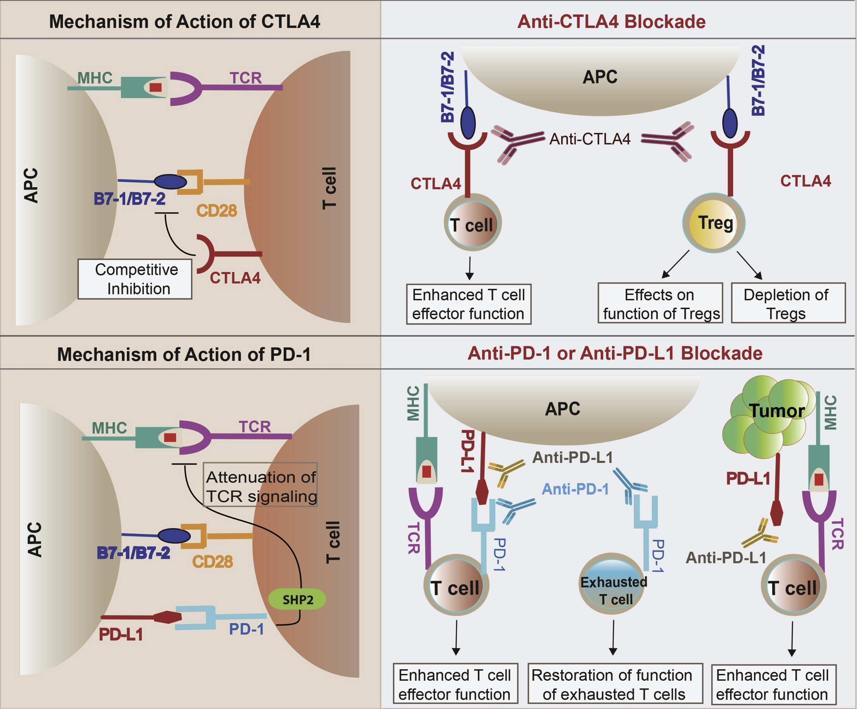
Immune checkpoint inhibitors (ICIs) have revolutionized cancer treatment
Khan et al. Semin Cancer Biol (2020)
Notes:
ICIs block inhibitory molecules that regulate T cells, releasing tumor-specific T cells to destroy tumor targets
Highlight PD-L1 on tumor cells
Clinical success of ICI, but only effective in some patients (~20-50% response rates)

Slide 3
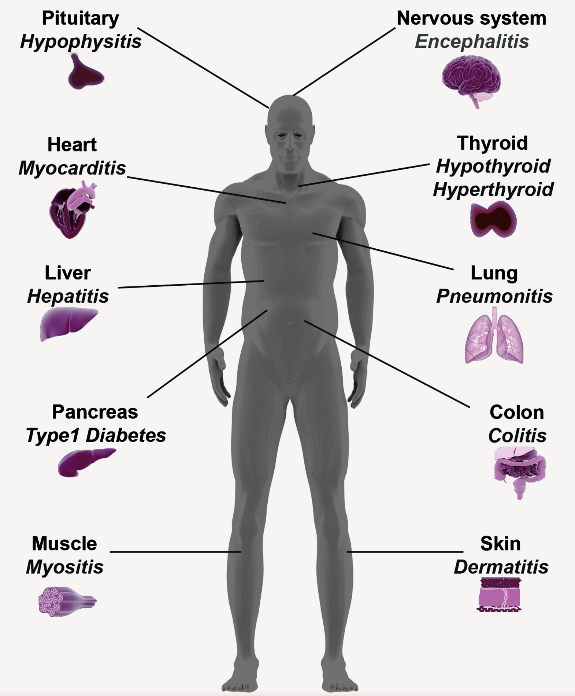
However, ICIs can lead to the development of immune-related adverse events (irAEs)
Khan et al. Semin Cancer Biol (2020)
Notes:
They’re (usually) transient autoimmune-like inflammatory pathologies
However, ICIs also release self-specific T cells to destroy self-targets (breach of self-tolerance), resulting in irAEs, autoimmune-like inflammatory pathologies (more transient, faster kinetics than autoimmune conditions)
irAEs are heterogeneous (organ-target), and have sometimes been associated with favorable response to ICI
individuals with preexisting autoimmune disease flare when treated with ICI

Slide 4
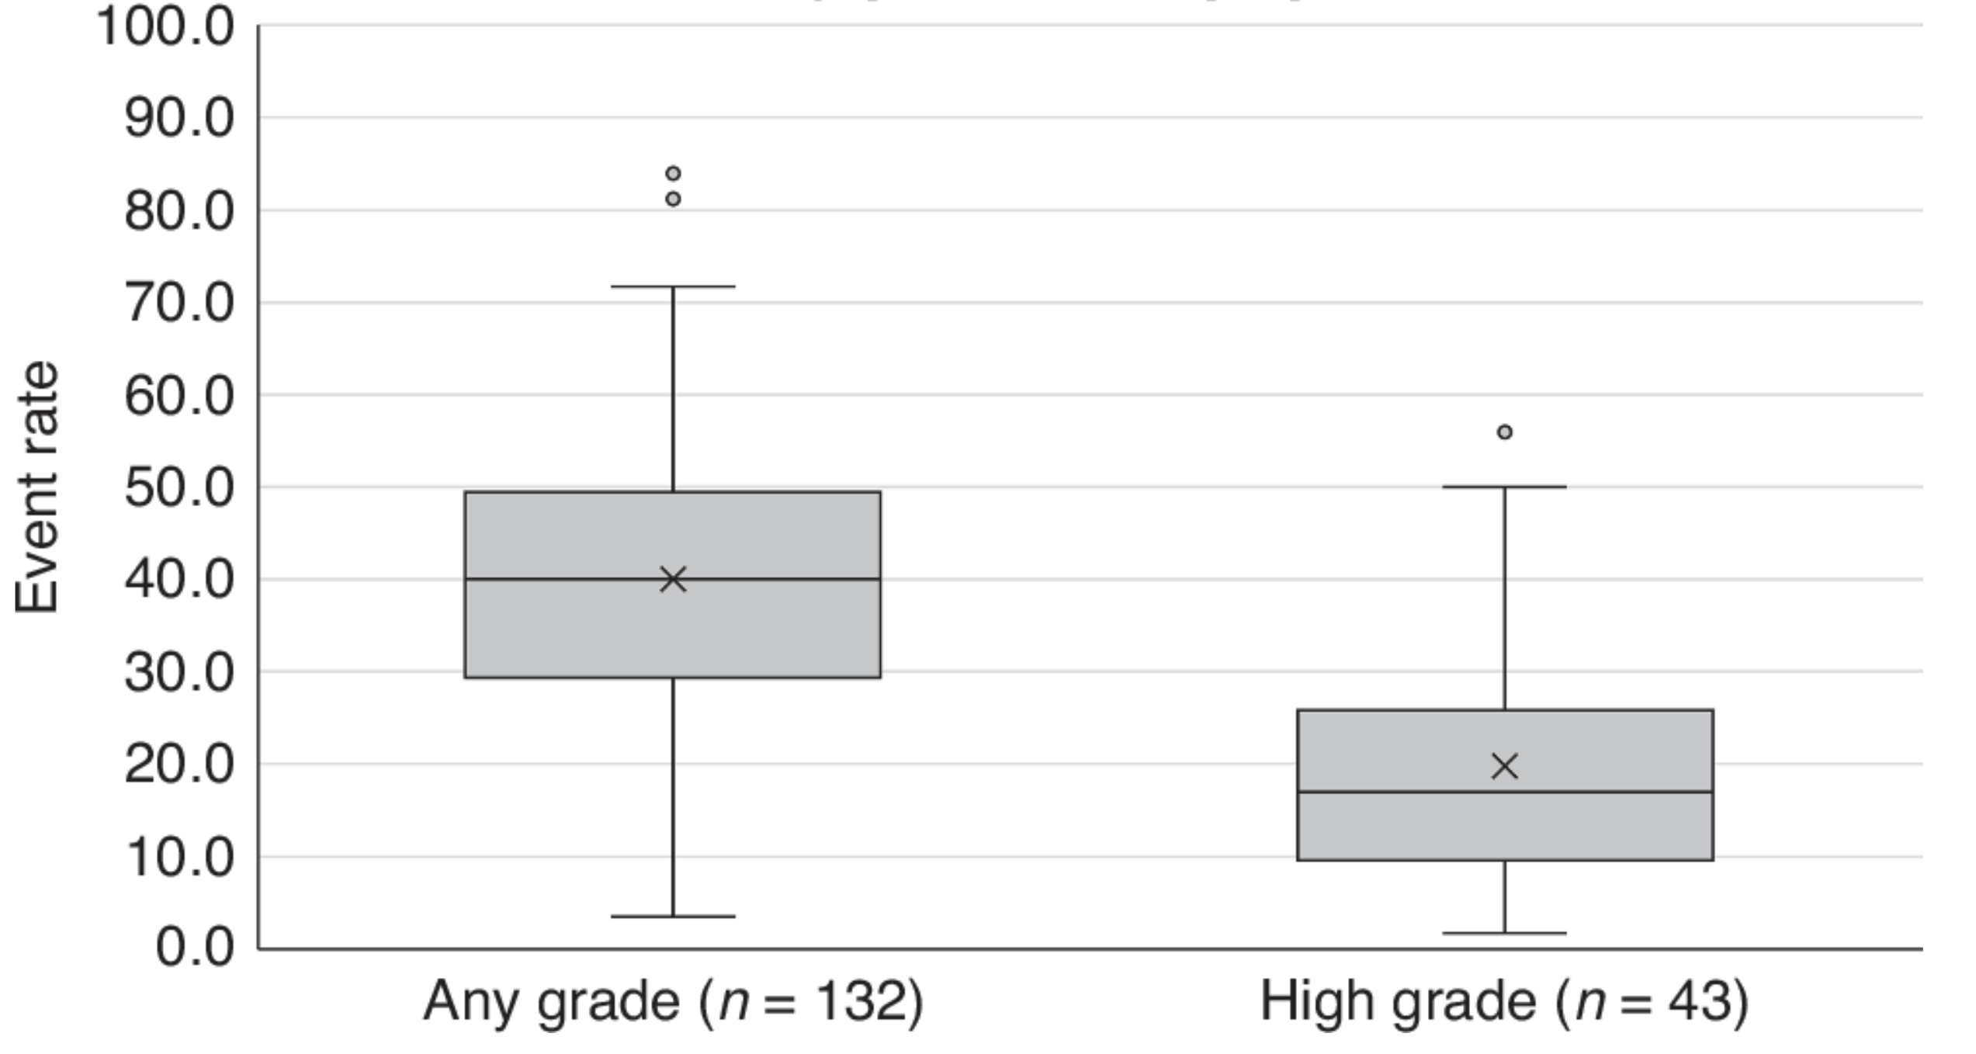
irAEs are common and can be severe
132 studies, 75,988 patients
43 studies, 25,607 patients
Jayathilaka et al. Br J Cancer (2024)
Notes:
irAEs affect quality of life AND can necessitate discontinuation of ICI which prevents full benefit of ICI therapy
Make sure to explain differences in 2 x-axis values, i.e. 1st is any irAE could be just like itching
Event rate was calculated for 132 (n = 75,988) and 43 (n = 25,607) studies that reported either general and high grade irAE occurrence, respectively

Slide 5
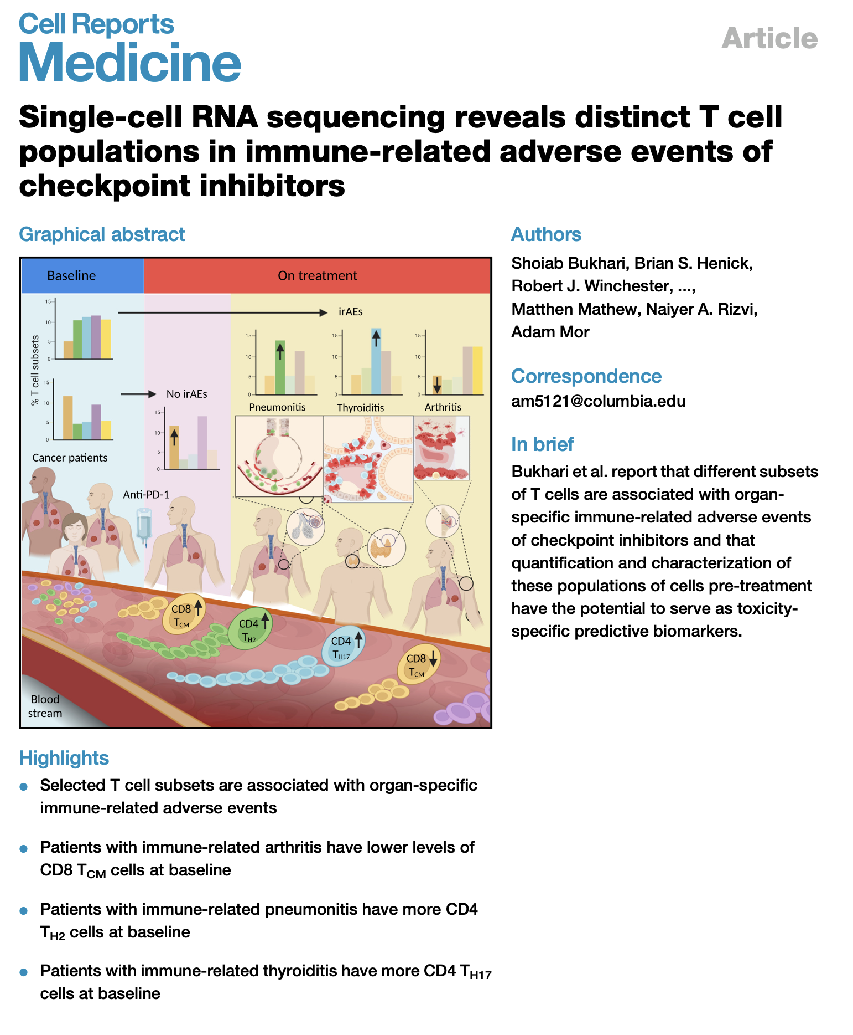
Different immune cell populations have been associated with distinct irAEs
Notes:
Different subsets maybe are irAE-type-specific due to different immune microenvironments of different organs
heterogeneity amongst irAE organs likely complicates prediction

Slide 6
Relationship between irAE development and overall response to ICI (OR) is still unclear
Notes:
Some observational studies have reported an association between irAE development and OR, BUT this hasn’t been asked extensively in randomized clinical trials (gold standard), and when it has been asked association has looked weak
THERE REMAINS A NEED for cellular/molecular markers for BOTH irAE development and response to ICI
Goal of course is to keep OR while minimizing irAEs, but that could be difficult given possible correlation/association, want to distinguish between the two…
Association would make sense with unleashing of previously restrained T cells… and possible shared antigens between tumor and self
Association may be more supported in cases of PD1-blockade not for CTLA-4 blockade
Literature supporting association:
Zhou et al. BMC Medicine (2020), for anti-PD-1 monotherapy
Cook et al. JAMA Netw Open (2024)
Foster et al. Cancer (2021)
Hsiehchen et al. Oncoimmunology (2022), more so for late-onset irAEs
Ye et al. Br J Cancer (2021)
Watson et al. JAMA Netw Open (2022)

Slide 7
Main goals
Are there immune cell populations predictive of irAE development/response to ICI?
Identifying how immune cell subsets change over ICI
Do some immune cell subsets change differently in those who do vs. don’t develop irAEs?
Do those who develop irAEs develop a more autoimmune-like immunotype?
Notes:
THERE REMAINS A NEED for cellular/molecular markers for BOTH irAE development and response to ICI (given unclear association)
Predicting who may be more likely to develop irAEs would be beneficial to increase monitoring in this patients, stratify use of healthcare resources for more at-risk populations
Highlight unique strength of our analyses is that we have AID cohort to compare irAE group to!
heterogeneity amongst irAE organs likely complicates prediction

Slide 8
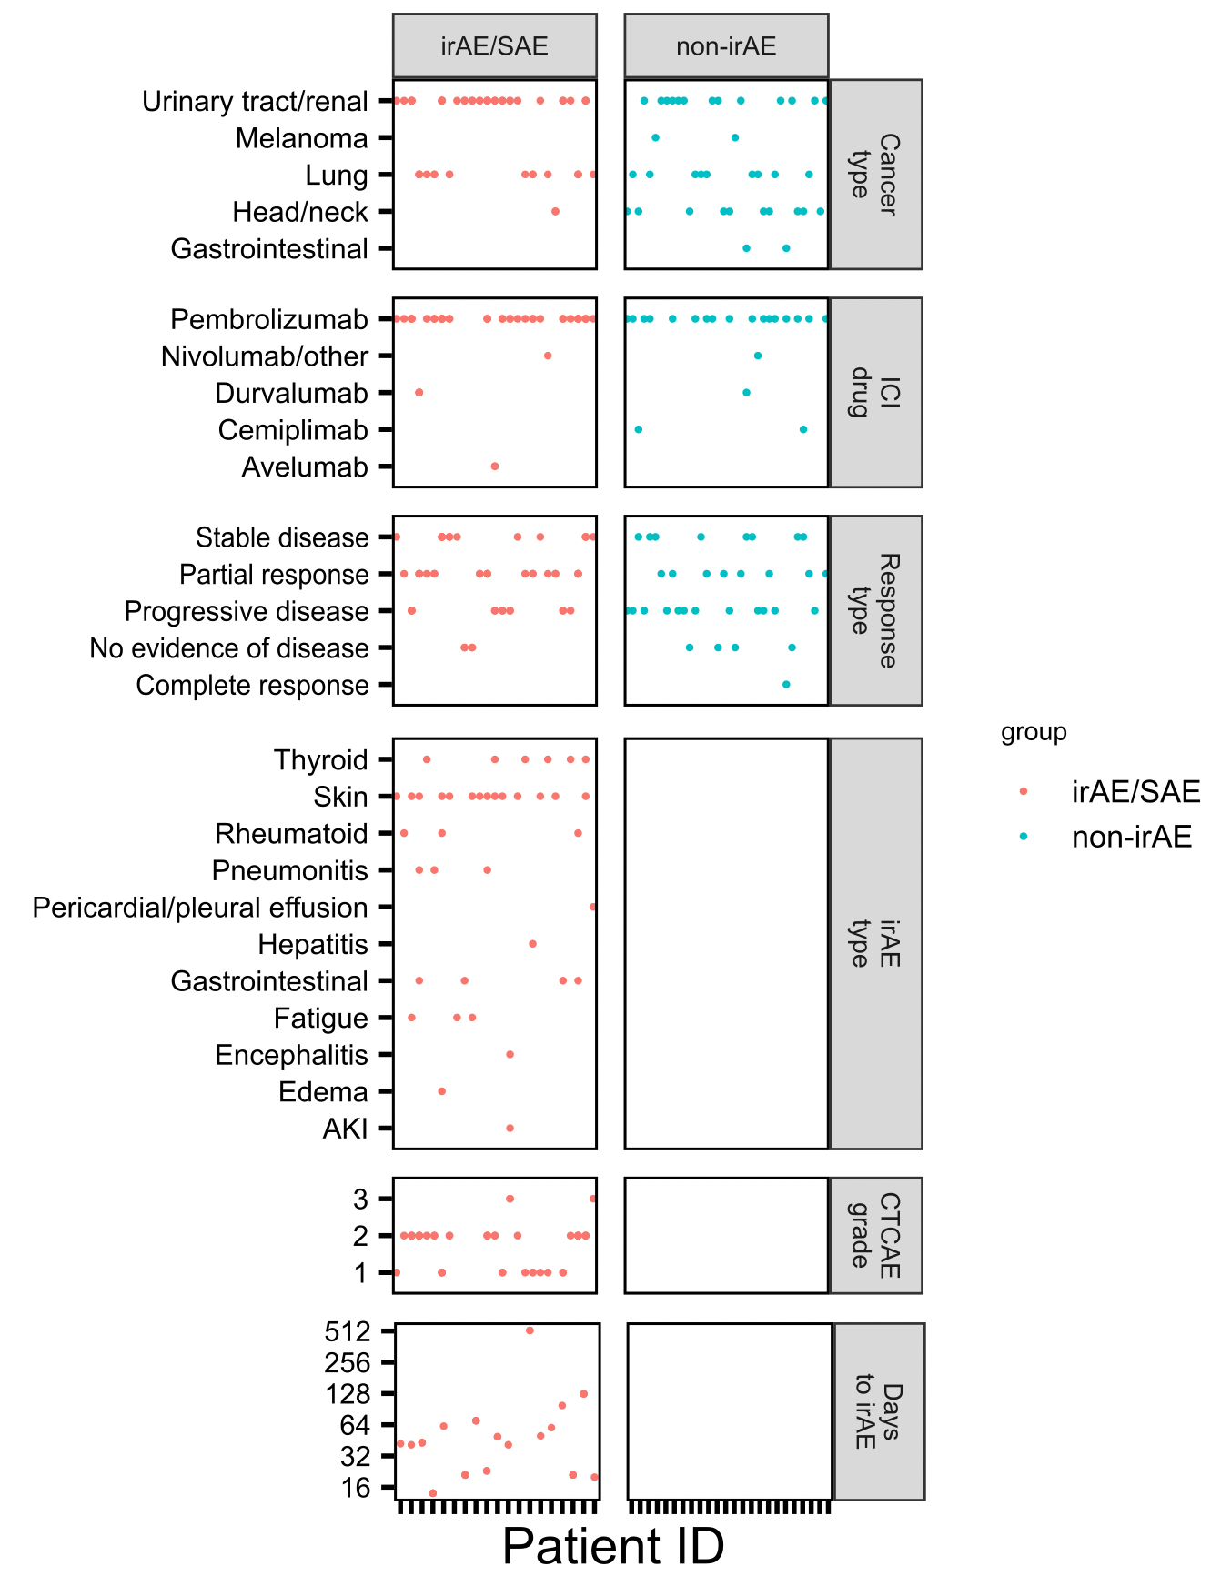
BRI ICI cohort
n = 36
n = 27
Clinical teams at VM, SCCA, U. of Texas
Notes:
Thyroid dysfunction is the most common endocrine irAE
Cancer: moreso what was available, not much melanoma at VM, + what’s treated with single class of checkpoint inhibitors + able to get large group size
ICI drug: moreso what was chosen by clinic (combination mostly for melanoma/more side effects too)
Lung approved 2nd after melanoma for PD-1 blockade
Durvalumab/avelumab are anti-PDL1

Slide 9
Patient draw schedule
Draw Schedule of NCI Subjects
Pre-ICI
After 1st ICI
After 2nd ICI
Near irAE
irAE follow-up
Core draws
irAE extra draws
End draw

Slide 10
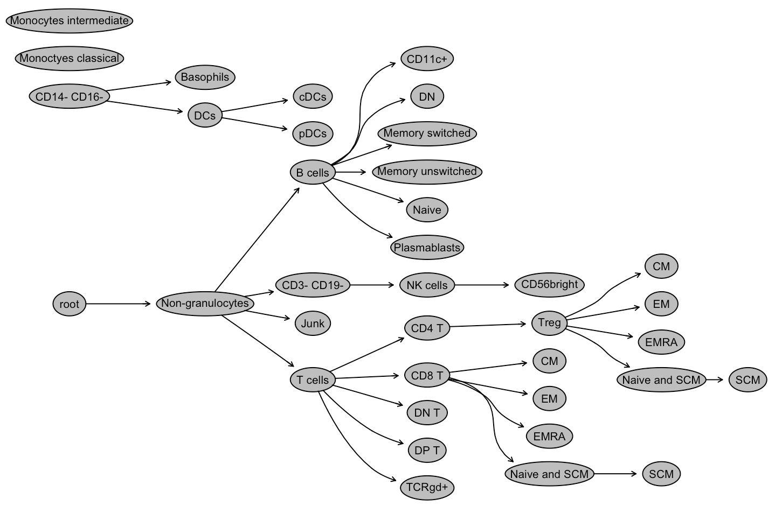
Analyzing peripheral immune cell populations with mass cytometry
Broad subsets (T, B, NK, monocytes…)
Memory subsets of T/B cells
Special CD4/CD8 subsets
PD1⁺ T/B/NK, PDL1⁺ monocytes
Alice Wiedeman
Notes:
Sample collection was a group effort done by a lot of people, collected blood from patients and froze down PBMCs
I was handed dataset from Alice W!
Was frozen PBMCs
Mass cytometry
80 reportables* (FlowJo, Alice Wiedeman)
Alice used Astrolabe cytometry cloud platform
cells stained with antibodies conjugated to rare metal isotopes, then cells are vaporized which turns metal-tagged antibodies into metal ions that are analyzed by mass spectrometer, output data is .fcs file with quantitative data for each measured metal ion (marker) per cell so like flow but higher dimensional data (more markers). then gating is done (after pre-processing/QC), where populations are identified by gating on markers that define broad/sub lineages

Slide 11
Manual gating of 80 specific immune cell subsets
Alice Wiedeman

Slide 12
Main goals
Are there immune cell populations predictive of irAE development/response to ICI?
Identifying how immune cell subsets change over ICI
Do some immune cell subsets change differently in those who do vs. don’t develop irAEs?
Do those who develop irAEs develop a more autoimmune-like immunotype?
Notes:
THERE REMAINS A NEED for cellular/molecular markers for BOTH irAE development and response to ICI (given unclear association)
Predicting who may be more likely to develop irAEs would be beneficial to increase monitoring in this patients, stratify use of healthcare resources for more at-risk populations
Highlight unique strength of our analyses is that we have AID cohort to compare irAE group to!
heterogeneity amongst irAE organs likely complicates prediction

Slide 13
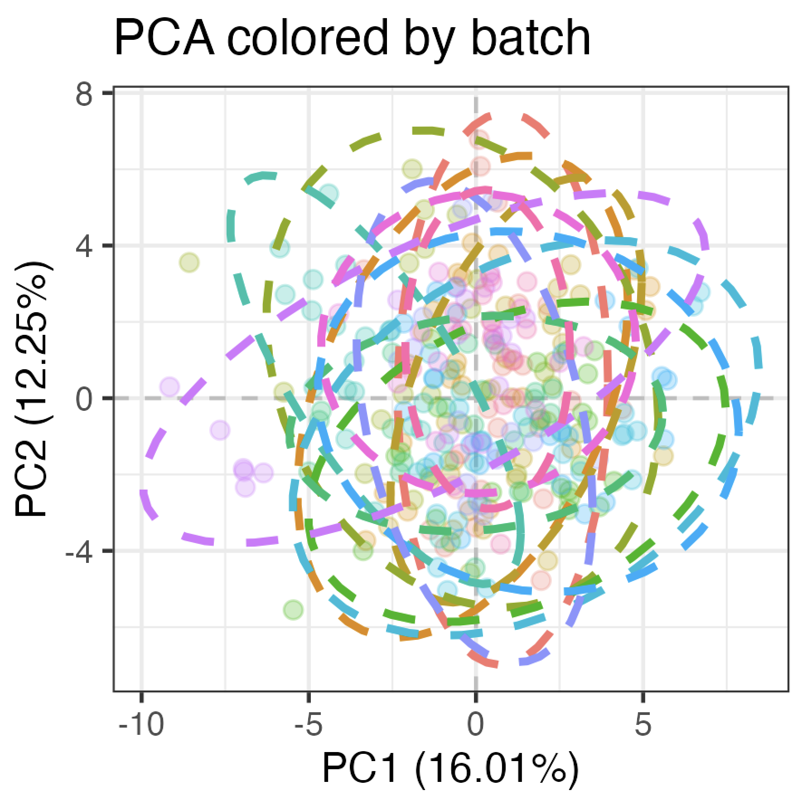
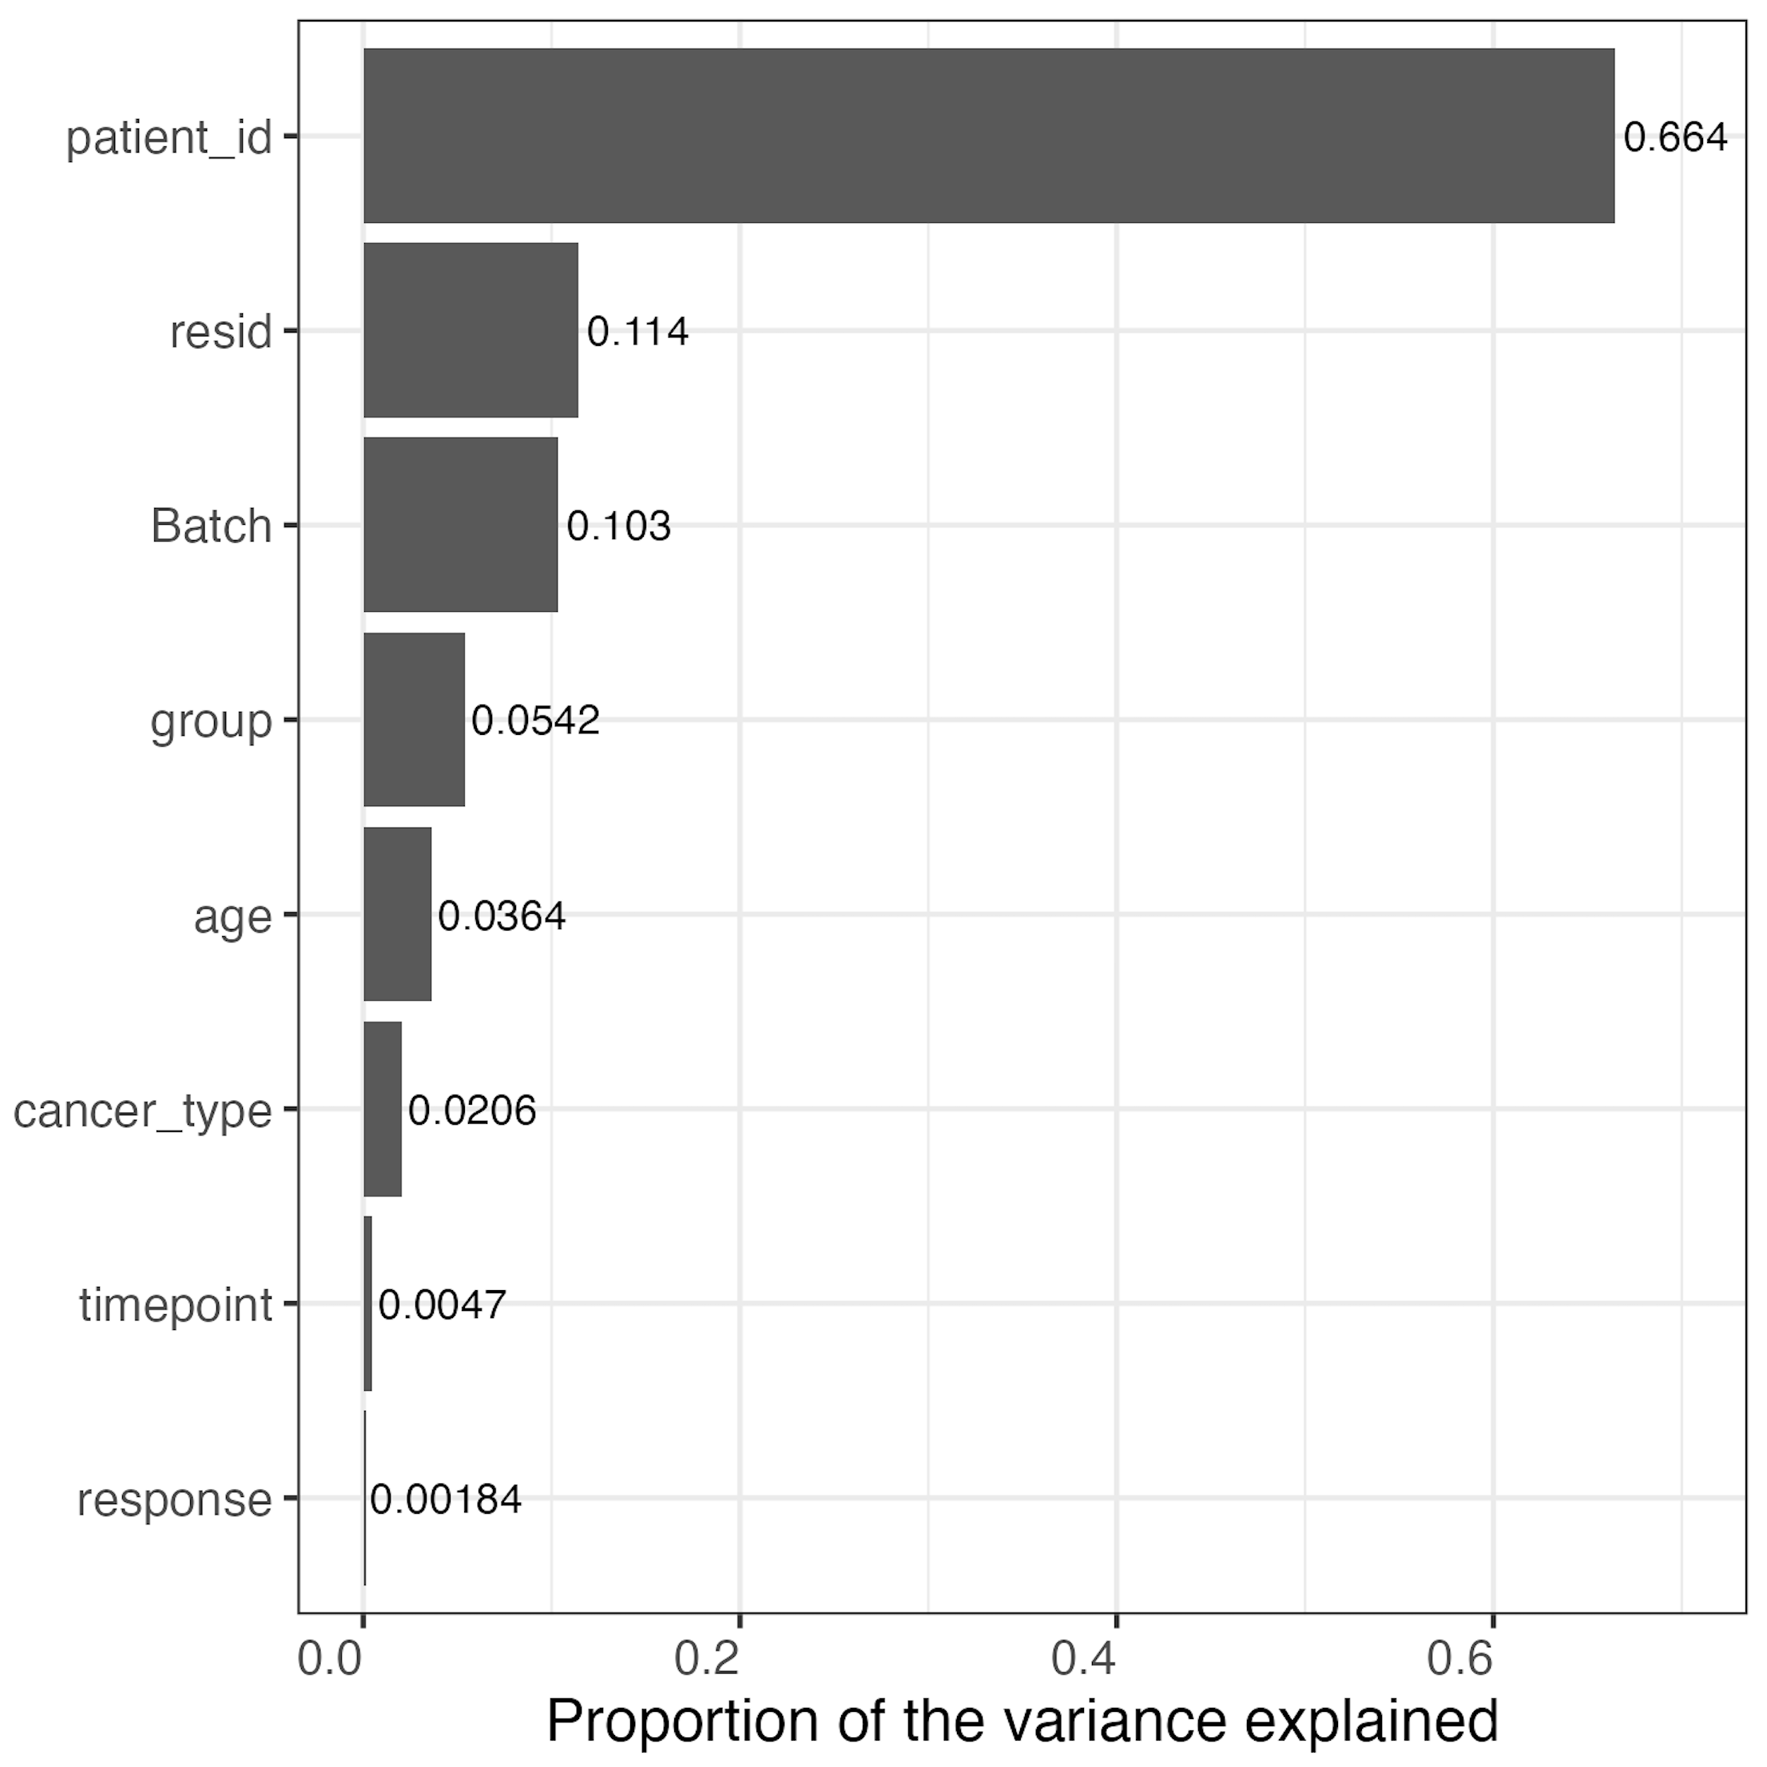
Methods overview
Remove 9 subsets with high technical variation
Logit transform percent of parent data to be more normally distributed
Use linear model with batch as a factor
freq ~ group*response + batch
Notes:
Transform necessary as many subsequent steps assume data is normal, also reduces unequal variance/skewness
Logit transforms 0-1 to –inf, inf to normalize data, basically log of odds ratio i.e. if freq is p then logit(p) = log2(p / (1-p)), also scaling to have mean of 0 and SD of 1
PVCA (Principal Variance Component Analysis)

Slide 14
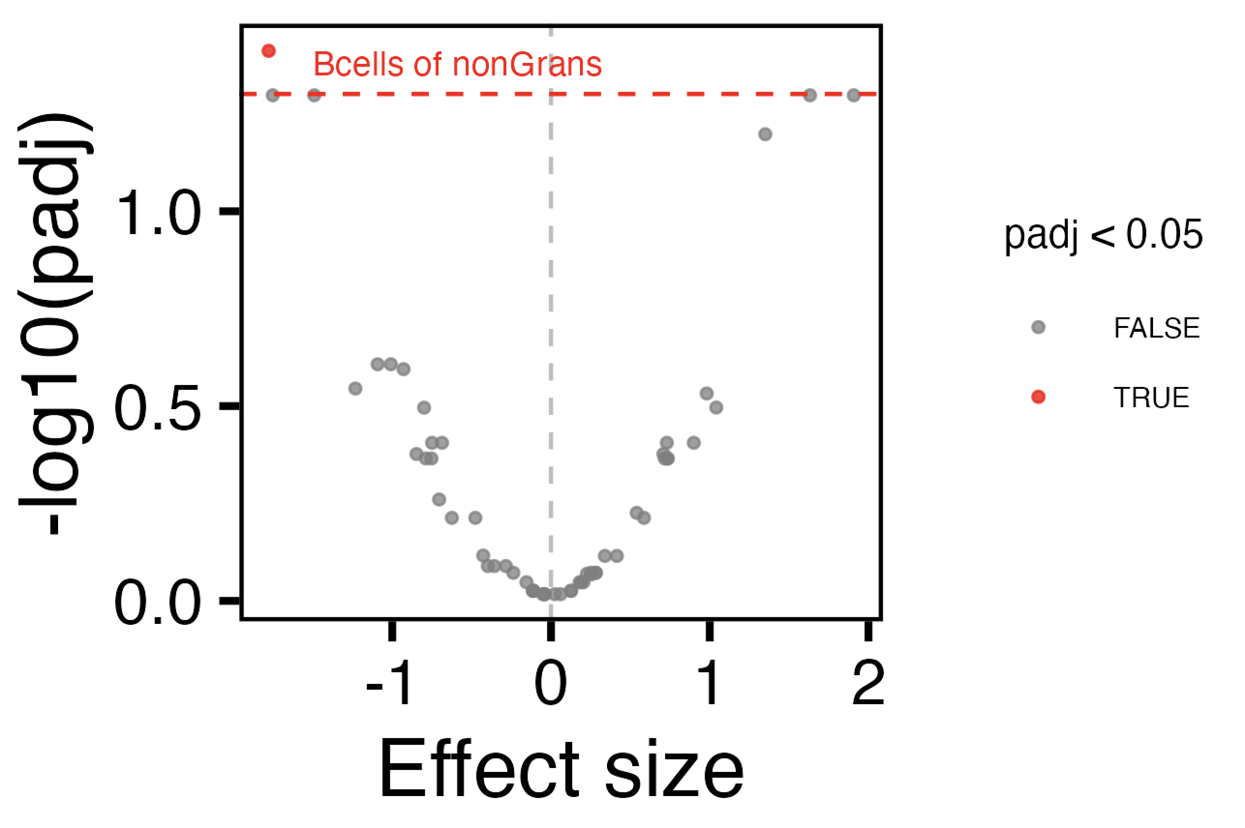
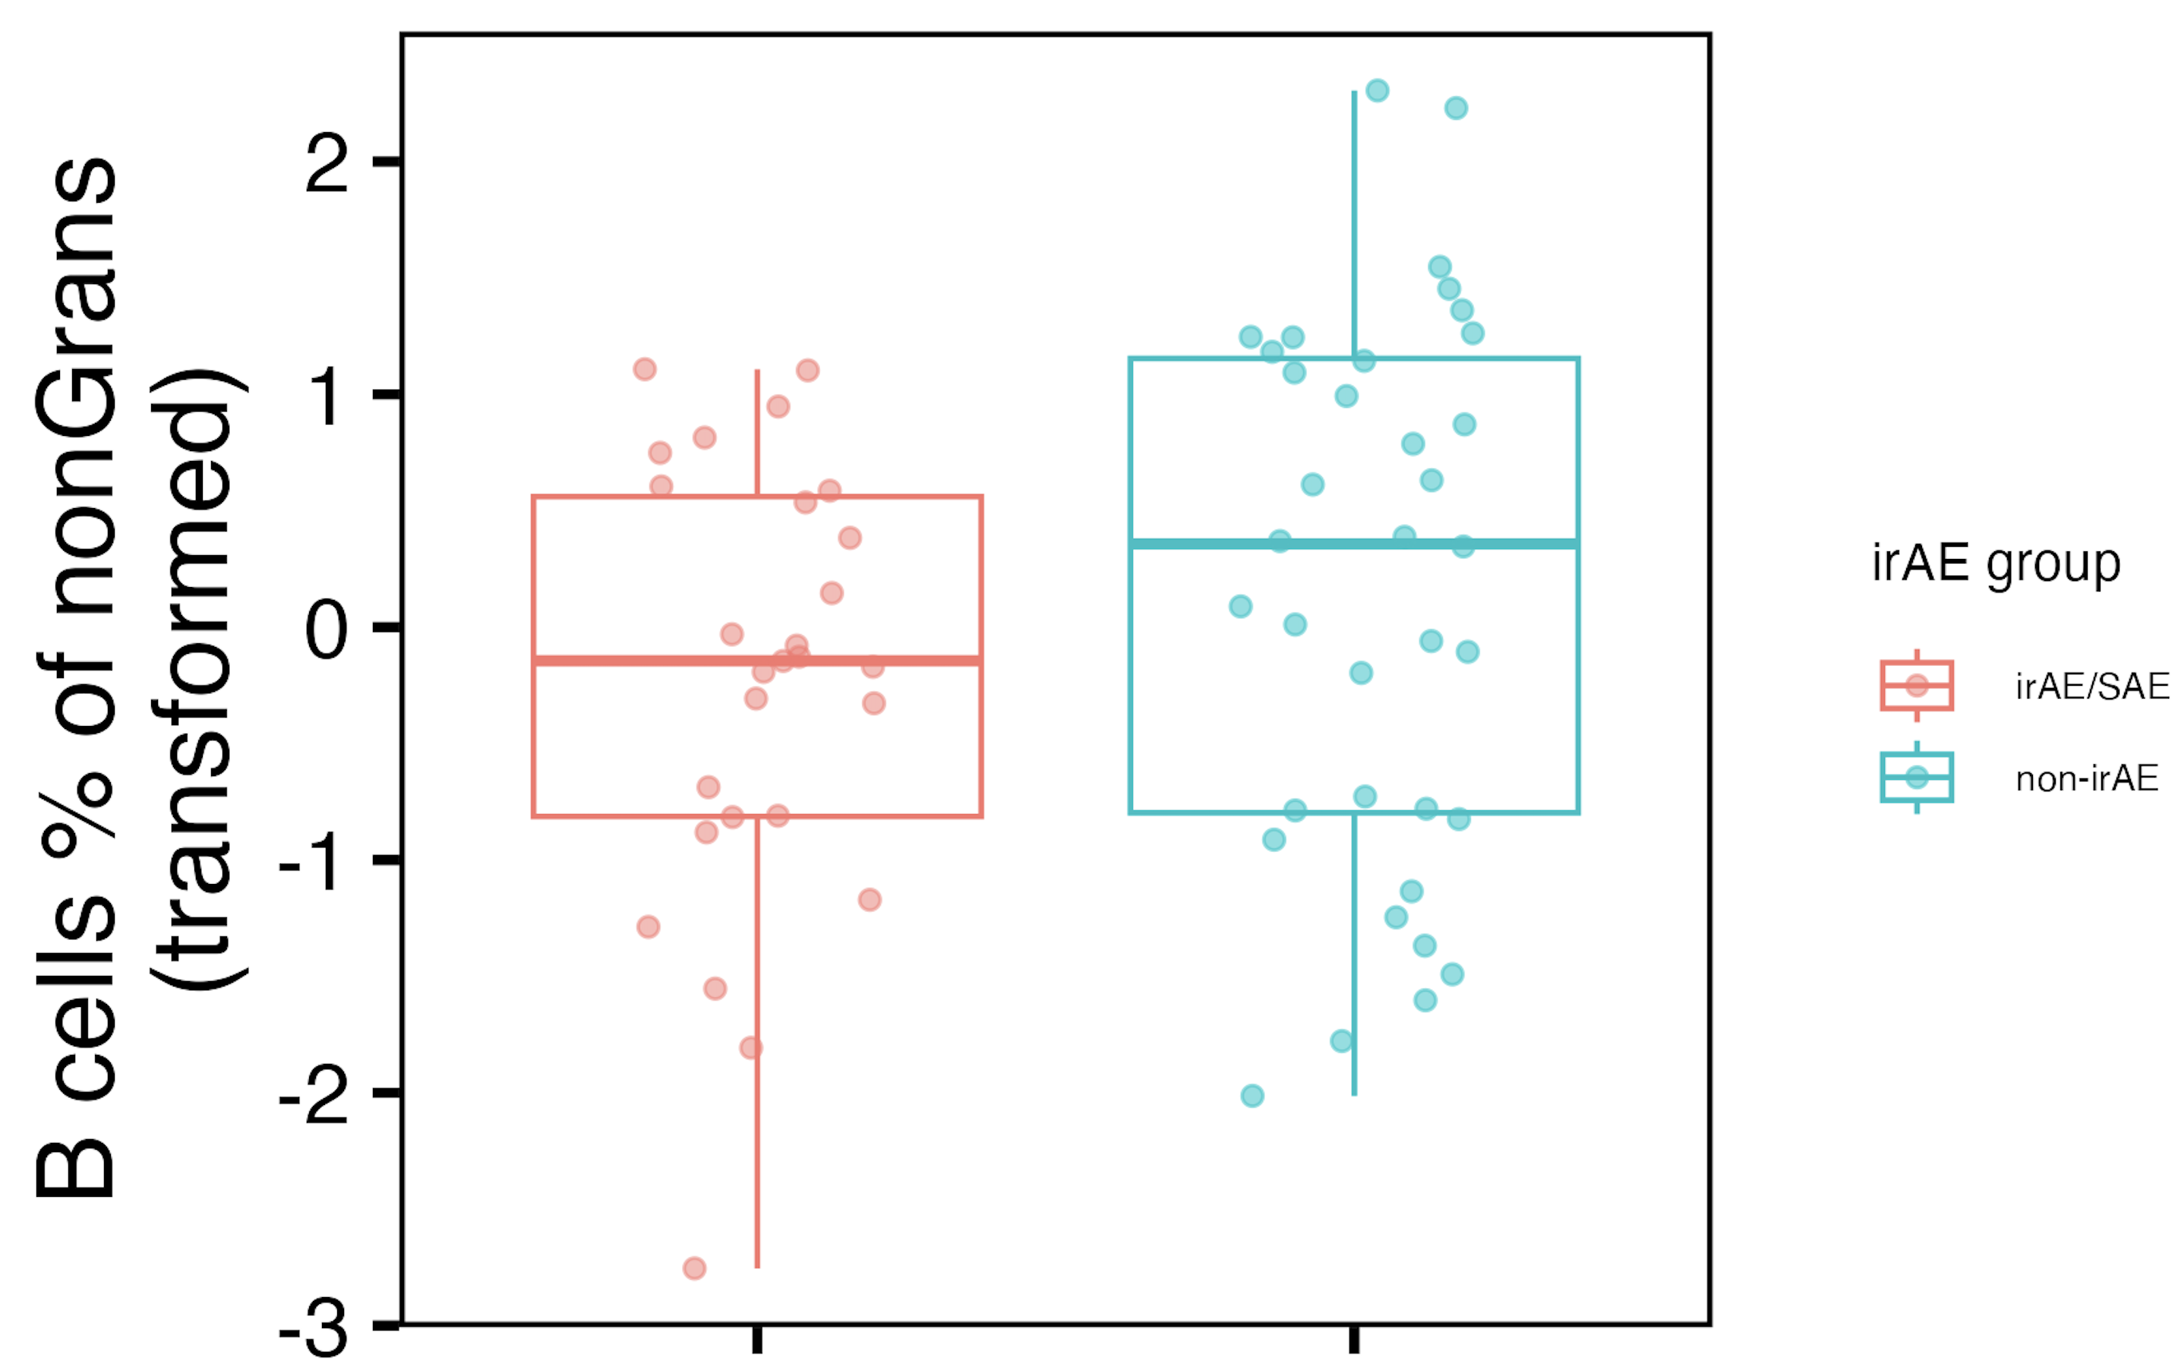
Baseline B cells of non-granulocyte frequency lower in irAE group
Higher in non-irAE
Higher in irAE
Notes:
Linear model
also see this for skin irAE vs. no skin irAE
Did an ANOVA for +/- interaction term and padj was < 0.1 for Bcells of nonGrans (combined irAE, padj < 0.15 for skin irAE), so interaction model ~better there so that’s good that I’m using it

Slide 15
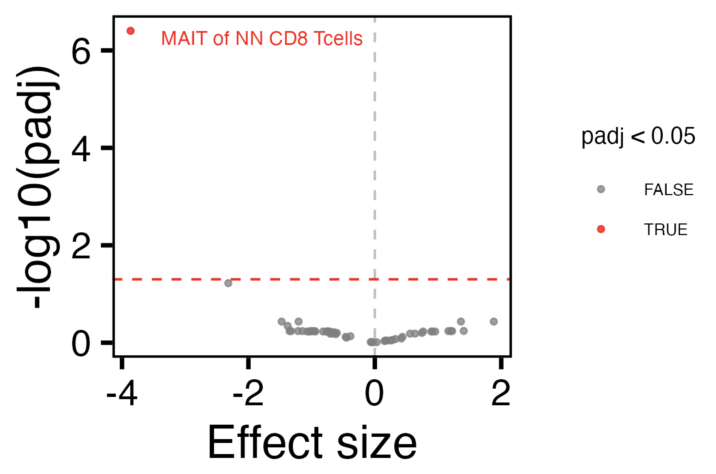
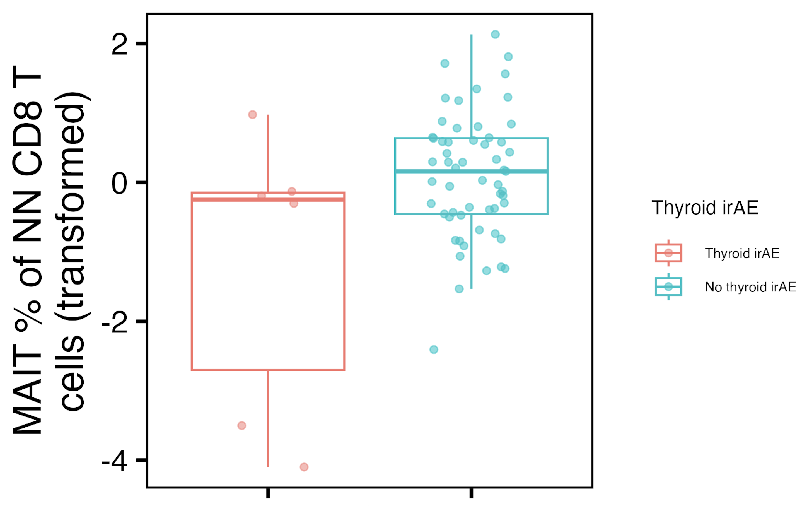
Baseline MAIT of non-naïve CD8 frequency lower in thyroid irAE group
Higher in non-thyroid irAE
Higher in thyroid irAE
Notes:
Linear model
Did an ANOVA for +/- interaction term and padj was < 0.05 for MAITs of NN CD8s, so interaction model better there so that’s good

Slide 16
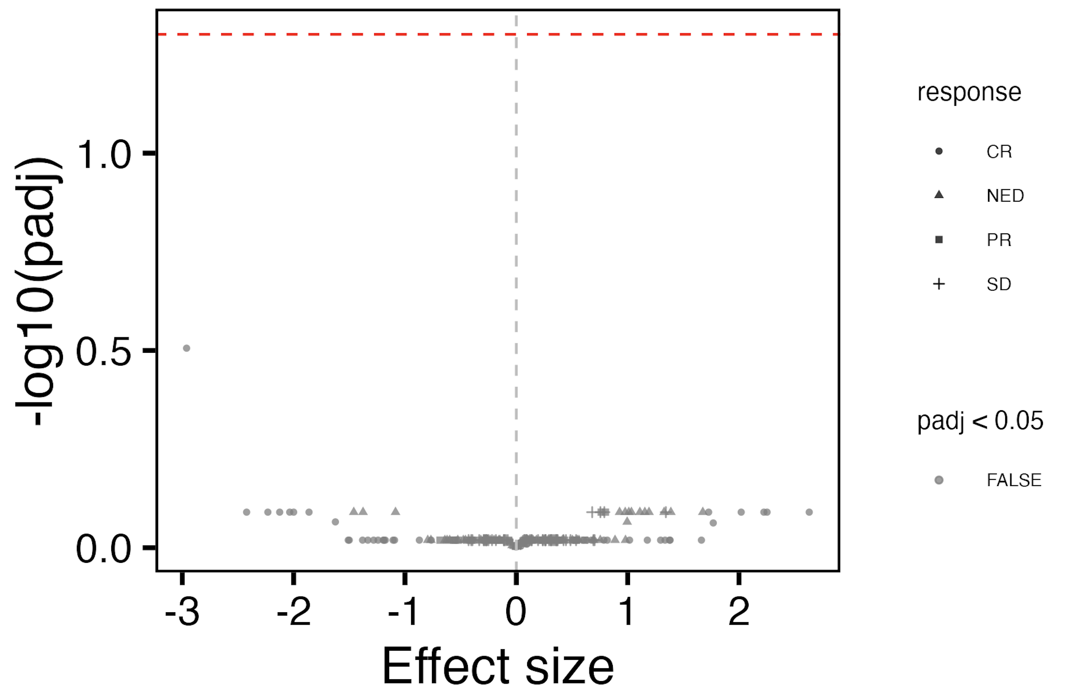
Different response types do not have different baseline immune cell frequencies
Higher in progressive disease
Higher in non-progressive disease

Slide 17
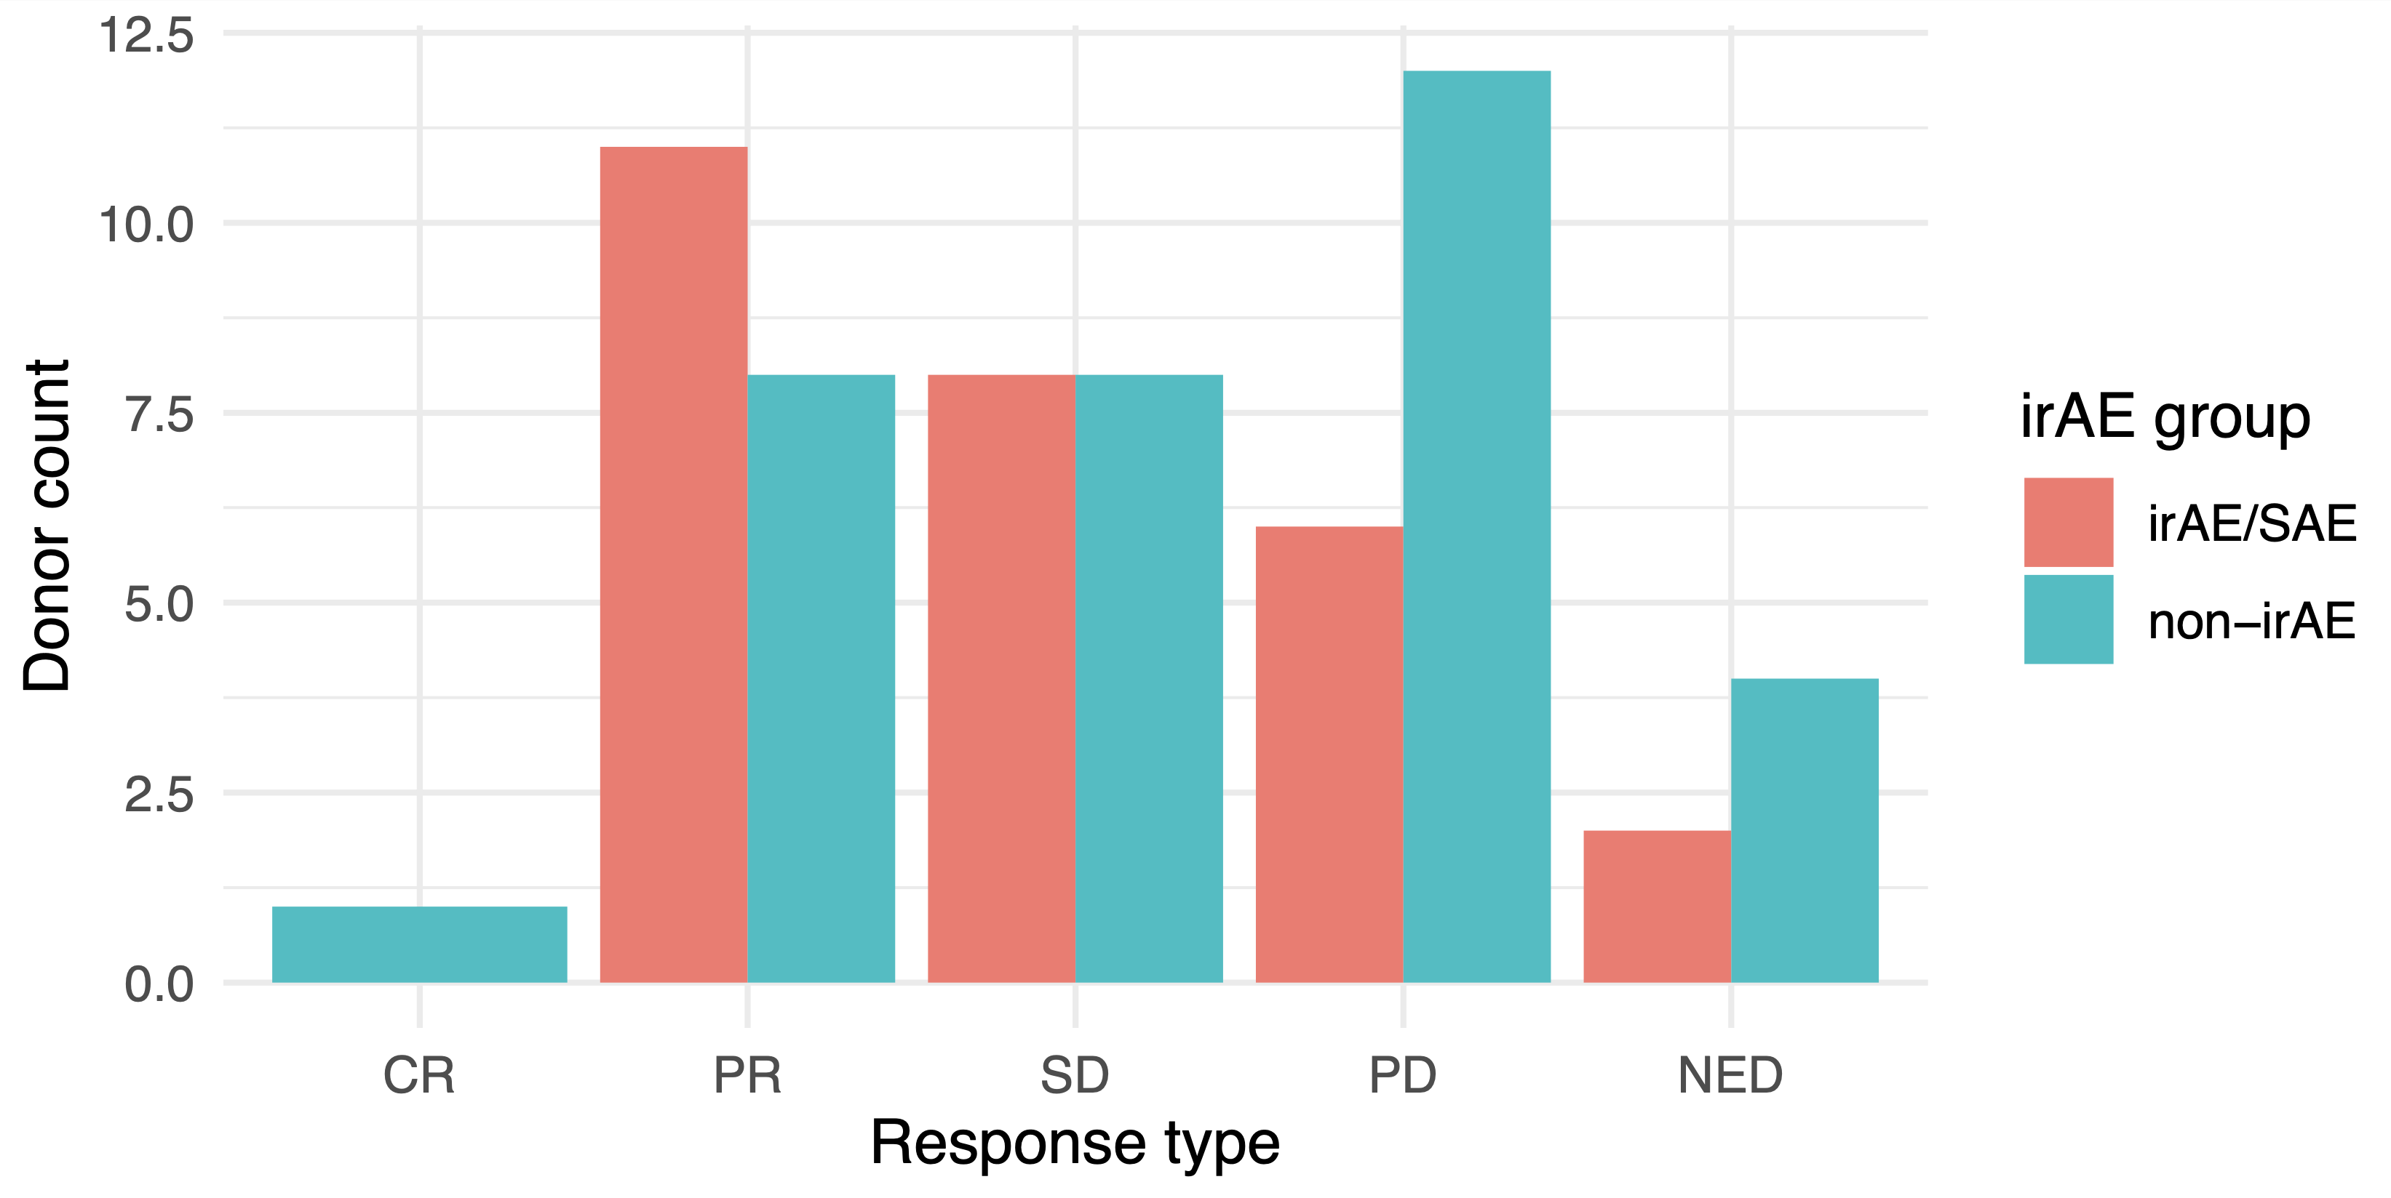
Response types are not significantly differentially distributed by irAE group
Fischer’s exact test pval: 0.5
Notes:
Pval 0.2 if just looking at PR and PD

Slide 18
Main goals
Are there immune cell populations predictive of irAE development/response to ICI?
Identifying how immune cell subsets change over ICI
Do some immune cell subsets change differently in those who do vs. don’t develop irAEs?
Do those who develop irAEs develop a more autoimmune-like immunotype?
Notes:
THERE REMAINS A NEED for cellular/molecular markers for BOTH irAE development and response to ICI (given unclear association)
Predicting who may be more likely to develop irAEs would be beneficial to increase monitoring in this patients, stratify use of healthcare resources for more at-risk populations
Highlight unique strength of our analyses is that we have AID cohort to compare irAE group to!
heterogeneity amongst irAE organs likely complicates prediction

Slide 19
Identifying which immune cell subsets change over ICI in irAE group/response-specific manner
Remove PD1⁺ subsets
For each subset
Model relationship between subset frequency and time on ICI with or without an interaction term between irAE group and time
Test if including interaction term improves model fit (ANOVA)
model_interaction <- gam(freq ~ irae_group + batch +
s(days_from_baseline, k = 5, bs = "cr") +
s(days_from_baseline, k = 5, bs = "cr", by = irae_group) +
s(patient_id, bs = "re"),
data = data, method = 'REML')
model_no_interaction <- gam(freq ~ irae_group + batch +
s(days_from_baseline, k = 5, bs = "cr") +
s(patient_id, bs = "re"),
data = data, method = 'REML')
Notes:
If model fit improves with interaction term (which ANOVA is testing), that means that the effect of time on ICI on subset frequency is different between irAE groups
Effects are likely also in those PD1+ subsets… we may indirectly assess these subsets by studying other IRs (like TIGIT) in IMPACD? possibly there may be CyTOF antibodies that don’t bind in same spot as blockade Ab?
Null hypothesis: The model without interaction (i.e., the simpler model) fits the data as well as the model with the interaction.
Alternative hypothesis: The model with the interaction term fits the data significantly better than the model without it, suggesting that the effect of days_from_baseline differs between groups.
REML (Restricted Maximum Likelihood) is a statistical technique used for parameter estimation, particularly in mixed-effects models and generalized additive models (GAMs)

Slide 20
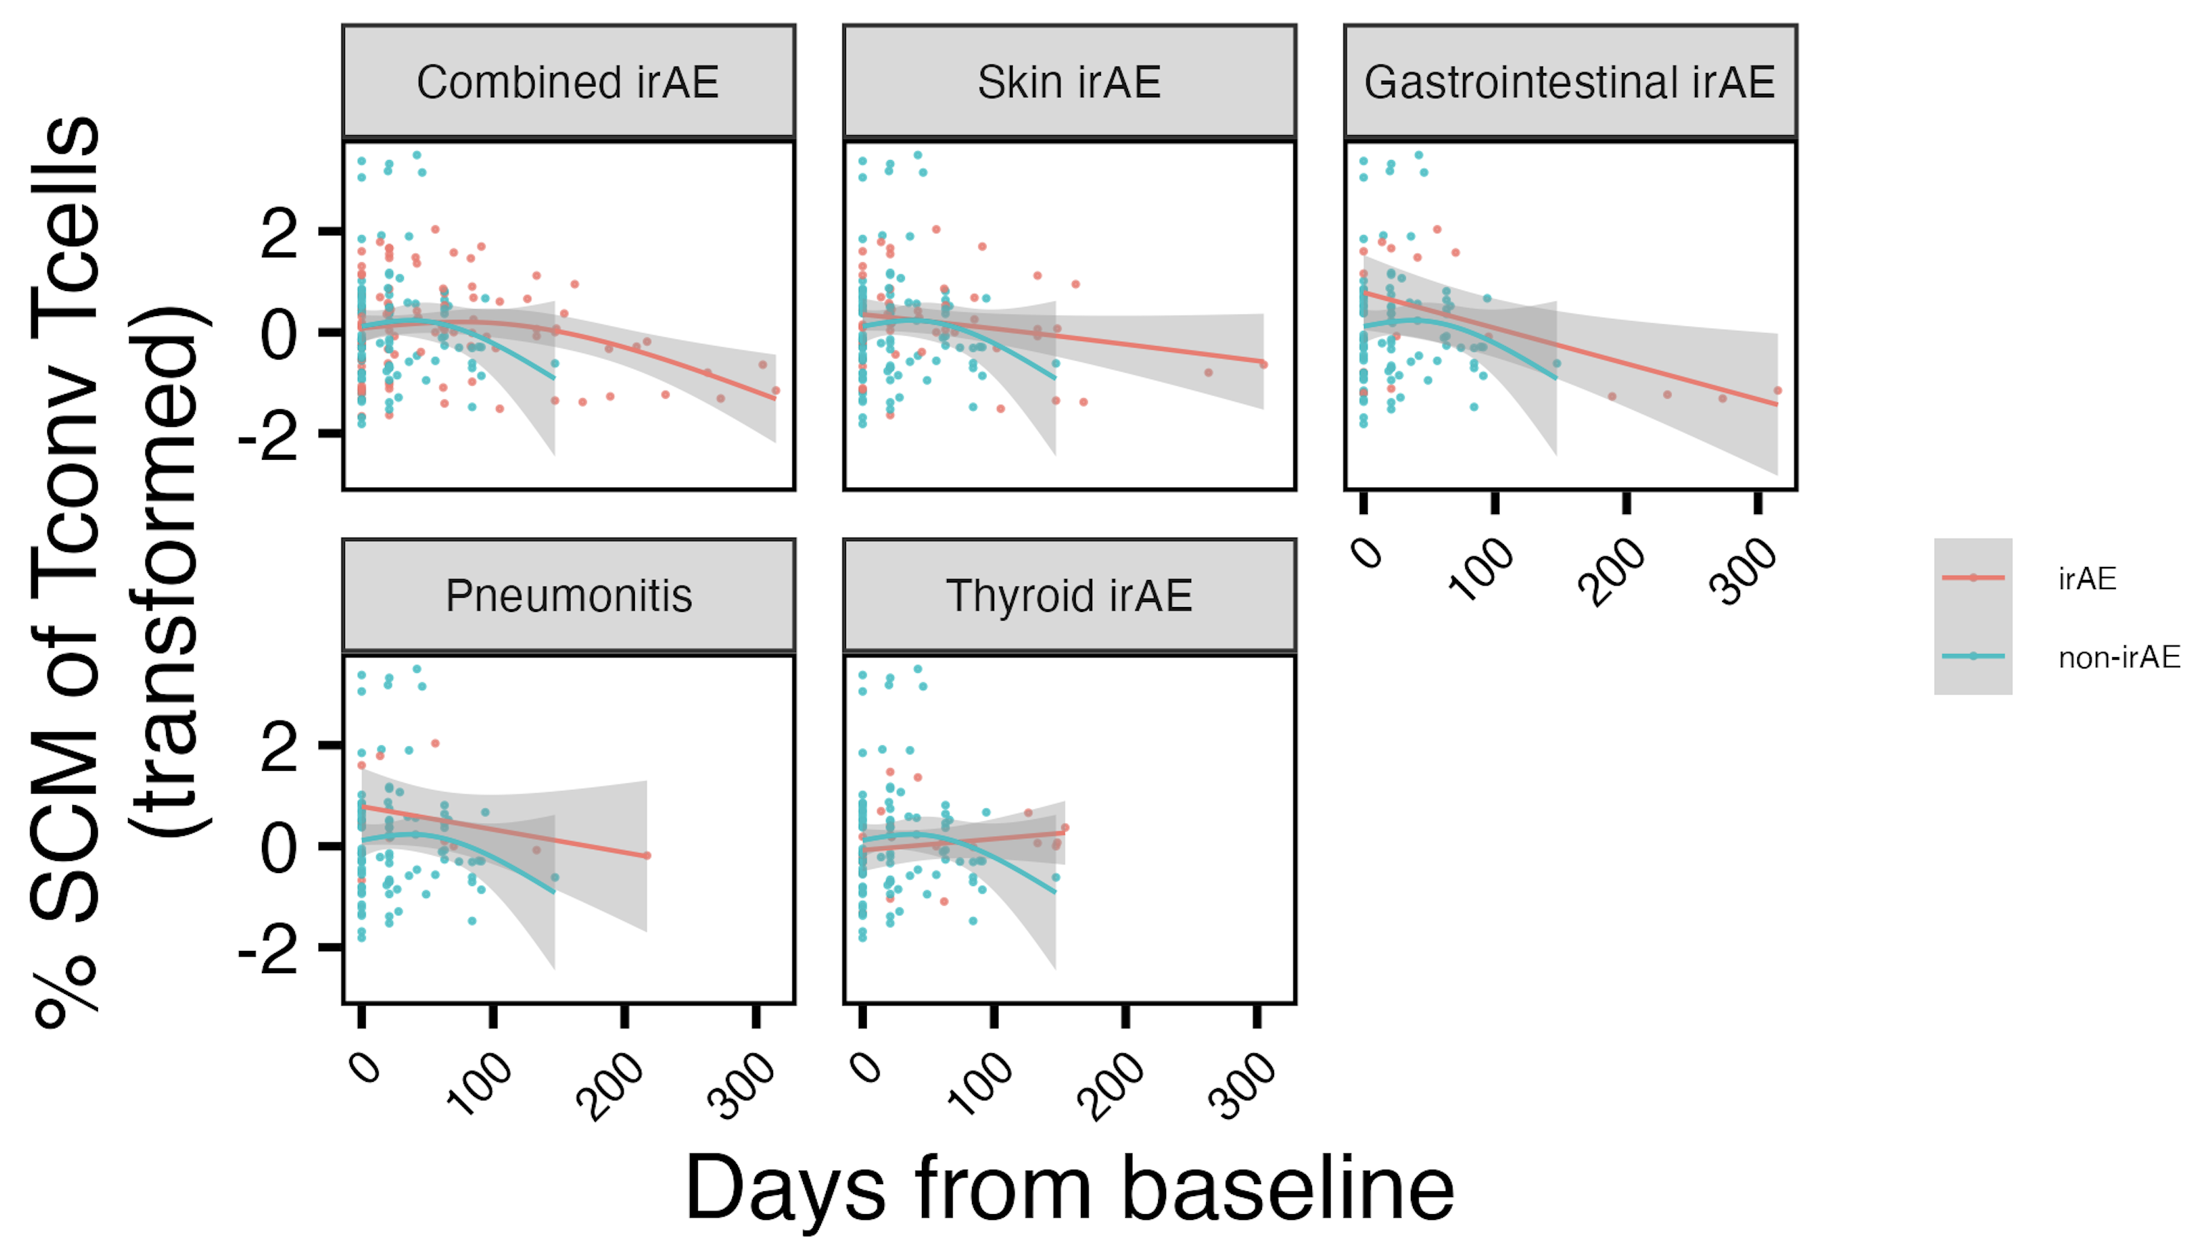
SCM of T_{conv} frequency on ICI generally higher in those with irAEs
*
~*
*
*
*
padj < 0.1: ~*
padj < 0.05: *
Notes:
These are all vs. no irAE

Slide 21
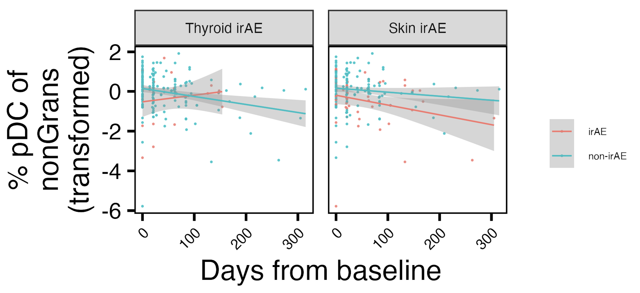
pDC of non-granulocyte frequency changes differently over ICI with different irAE types
*
*
padj < 0.05: *
Notes:
These are vs. non-type so skin vs. non-skin and thyroid vs. non-thyroid

Slide 22
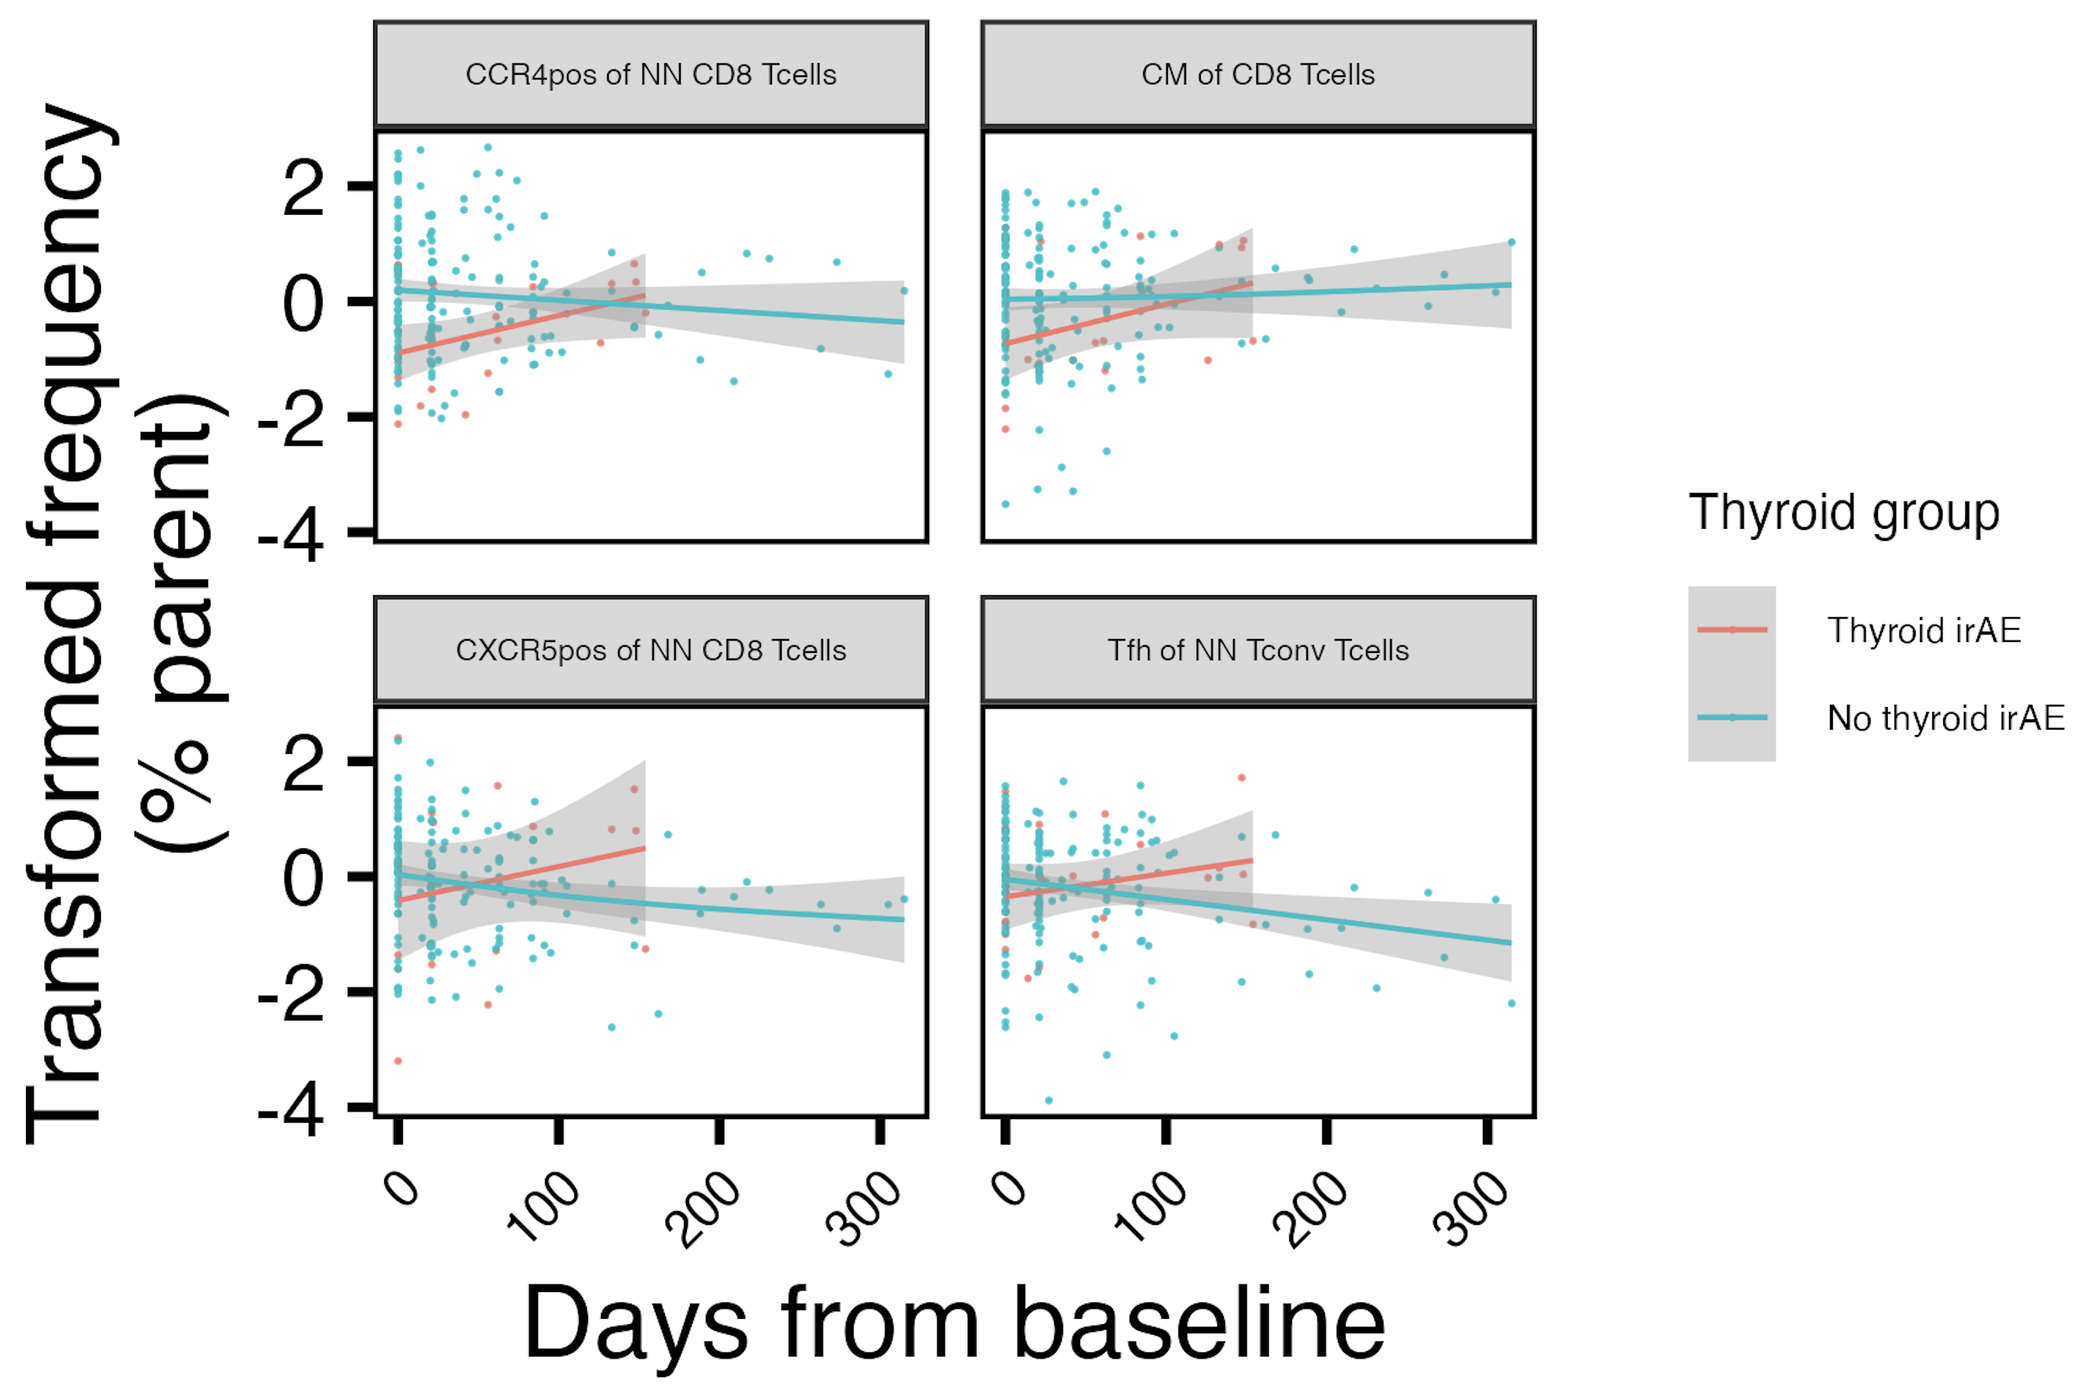
Development of thyroid irAEs is accompanied by increases in several T cell population frequencies
~*
~*
~*
~*
padj < 0.1: ~*

Slide 23
Main goals
Are there immune cell populations predictive of irAE development/response to ICI?
Identifying how immune cell subsets change over ICI
Do some immune cell subsets change differently in those who do vs. don’t develop irAEs?
Do those who develop irAEs develop a more autoimmune-like immunotype?
Notes:
THERE REMAINS A NEED for cellular/molecular markers for BOTH irAE development and response to ICI (given unclear association)
Predicting who may be more likely to develop irAEs would be beneficial to increase monitoring in this patients, stratify use of healthcare resources for more at-risk populations
Highlight unique strength of our analyses is that we have AID cohort to compare irAE group to!
heterogeneity amongst irAE organs likely complicates prediction

Slide 24
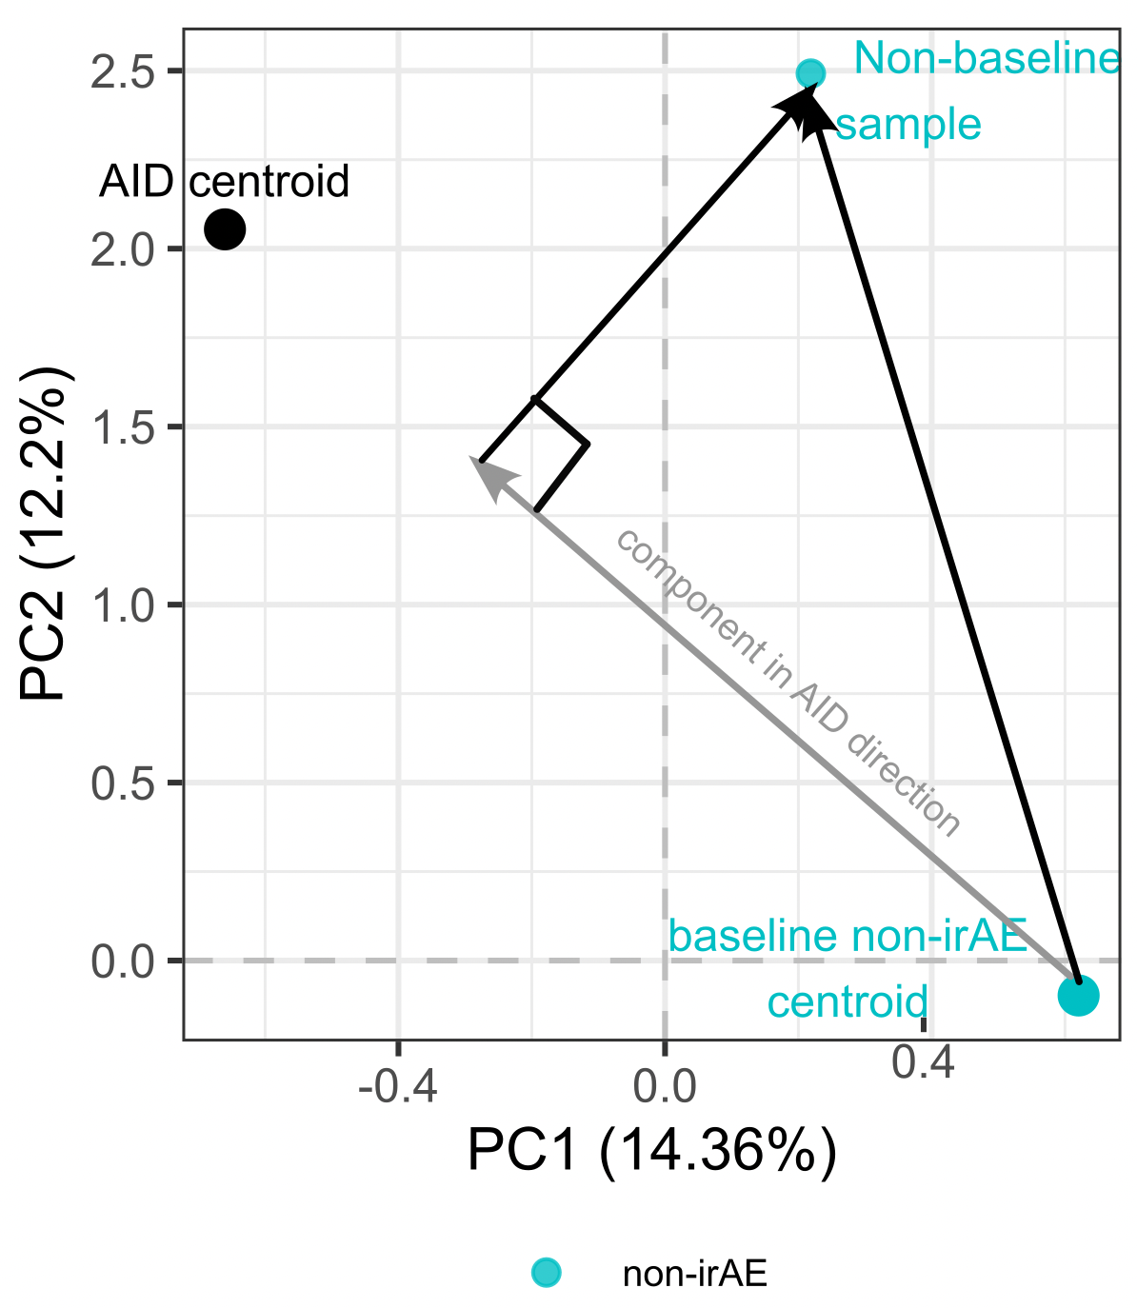
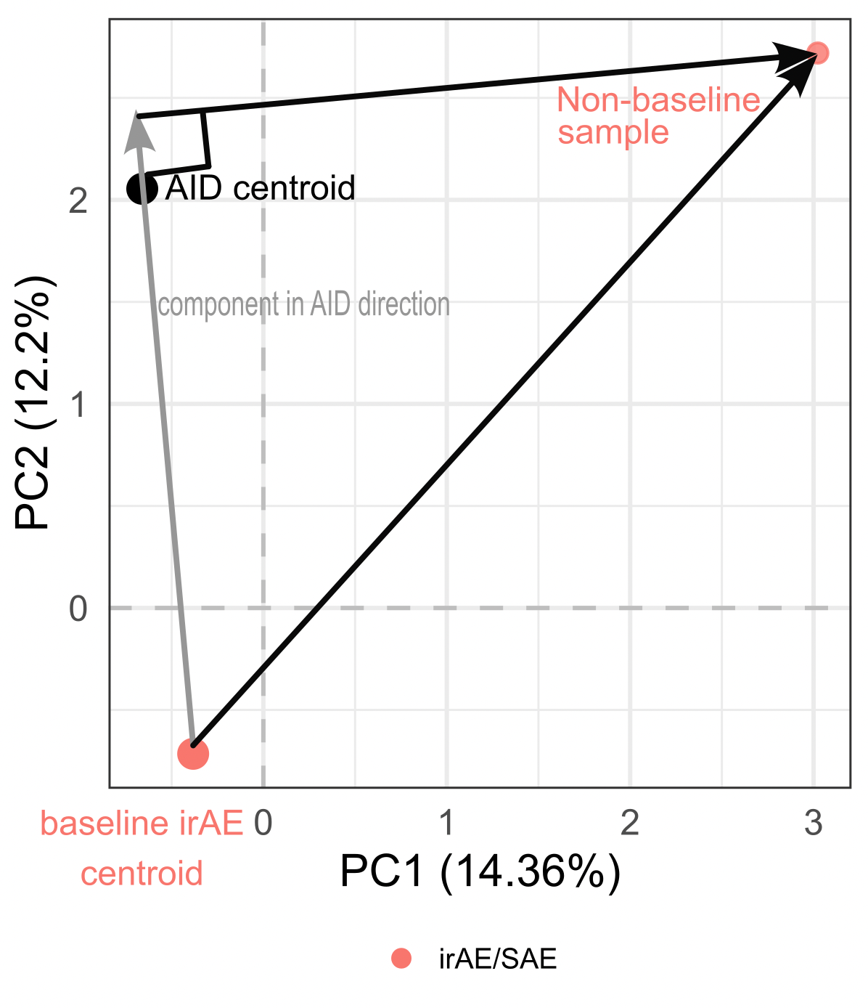
Identifying if immunotypes of irAE group become more autoimmune-like over ICI
non-irAE example
irAE example
Grey lines show components of ICI effects in direction of AID, are these more positive in irAE group?
Notes:
Find centroids of autoimmune and baseline cancer data (for irAE/no irAE groups) in original high dimensional space
Define lines from baseline cancer centroids (irAE/no irAE ones) to/through autoimmune centroid
For each patient for each longitudinal sample, draw line from their baseline group centroid to that data point
Find component of those lines (step 4) in baseline-AID line (step 3), more positive meaning more in direction of AID immunotype
Longitudinal data, draw schedule: visits 2/3 after 1st/2nd infusion (ICI)
So we’re doing projection of vector from cancer baseline centroid to longitudinal point, projection of that onto vector from centroid of baseline cancer to AID centroid

Slide 25
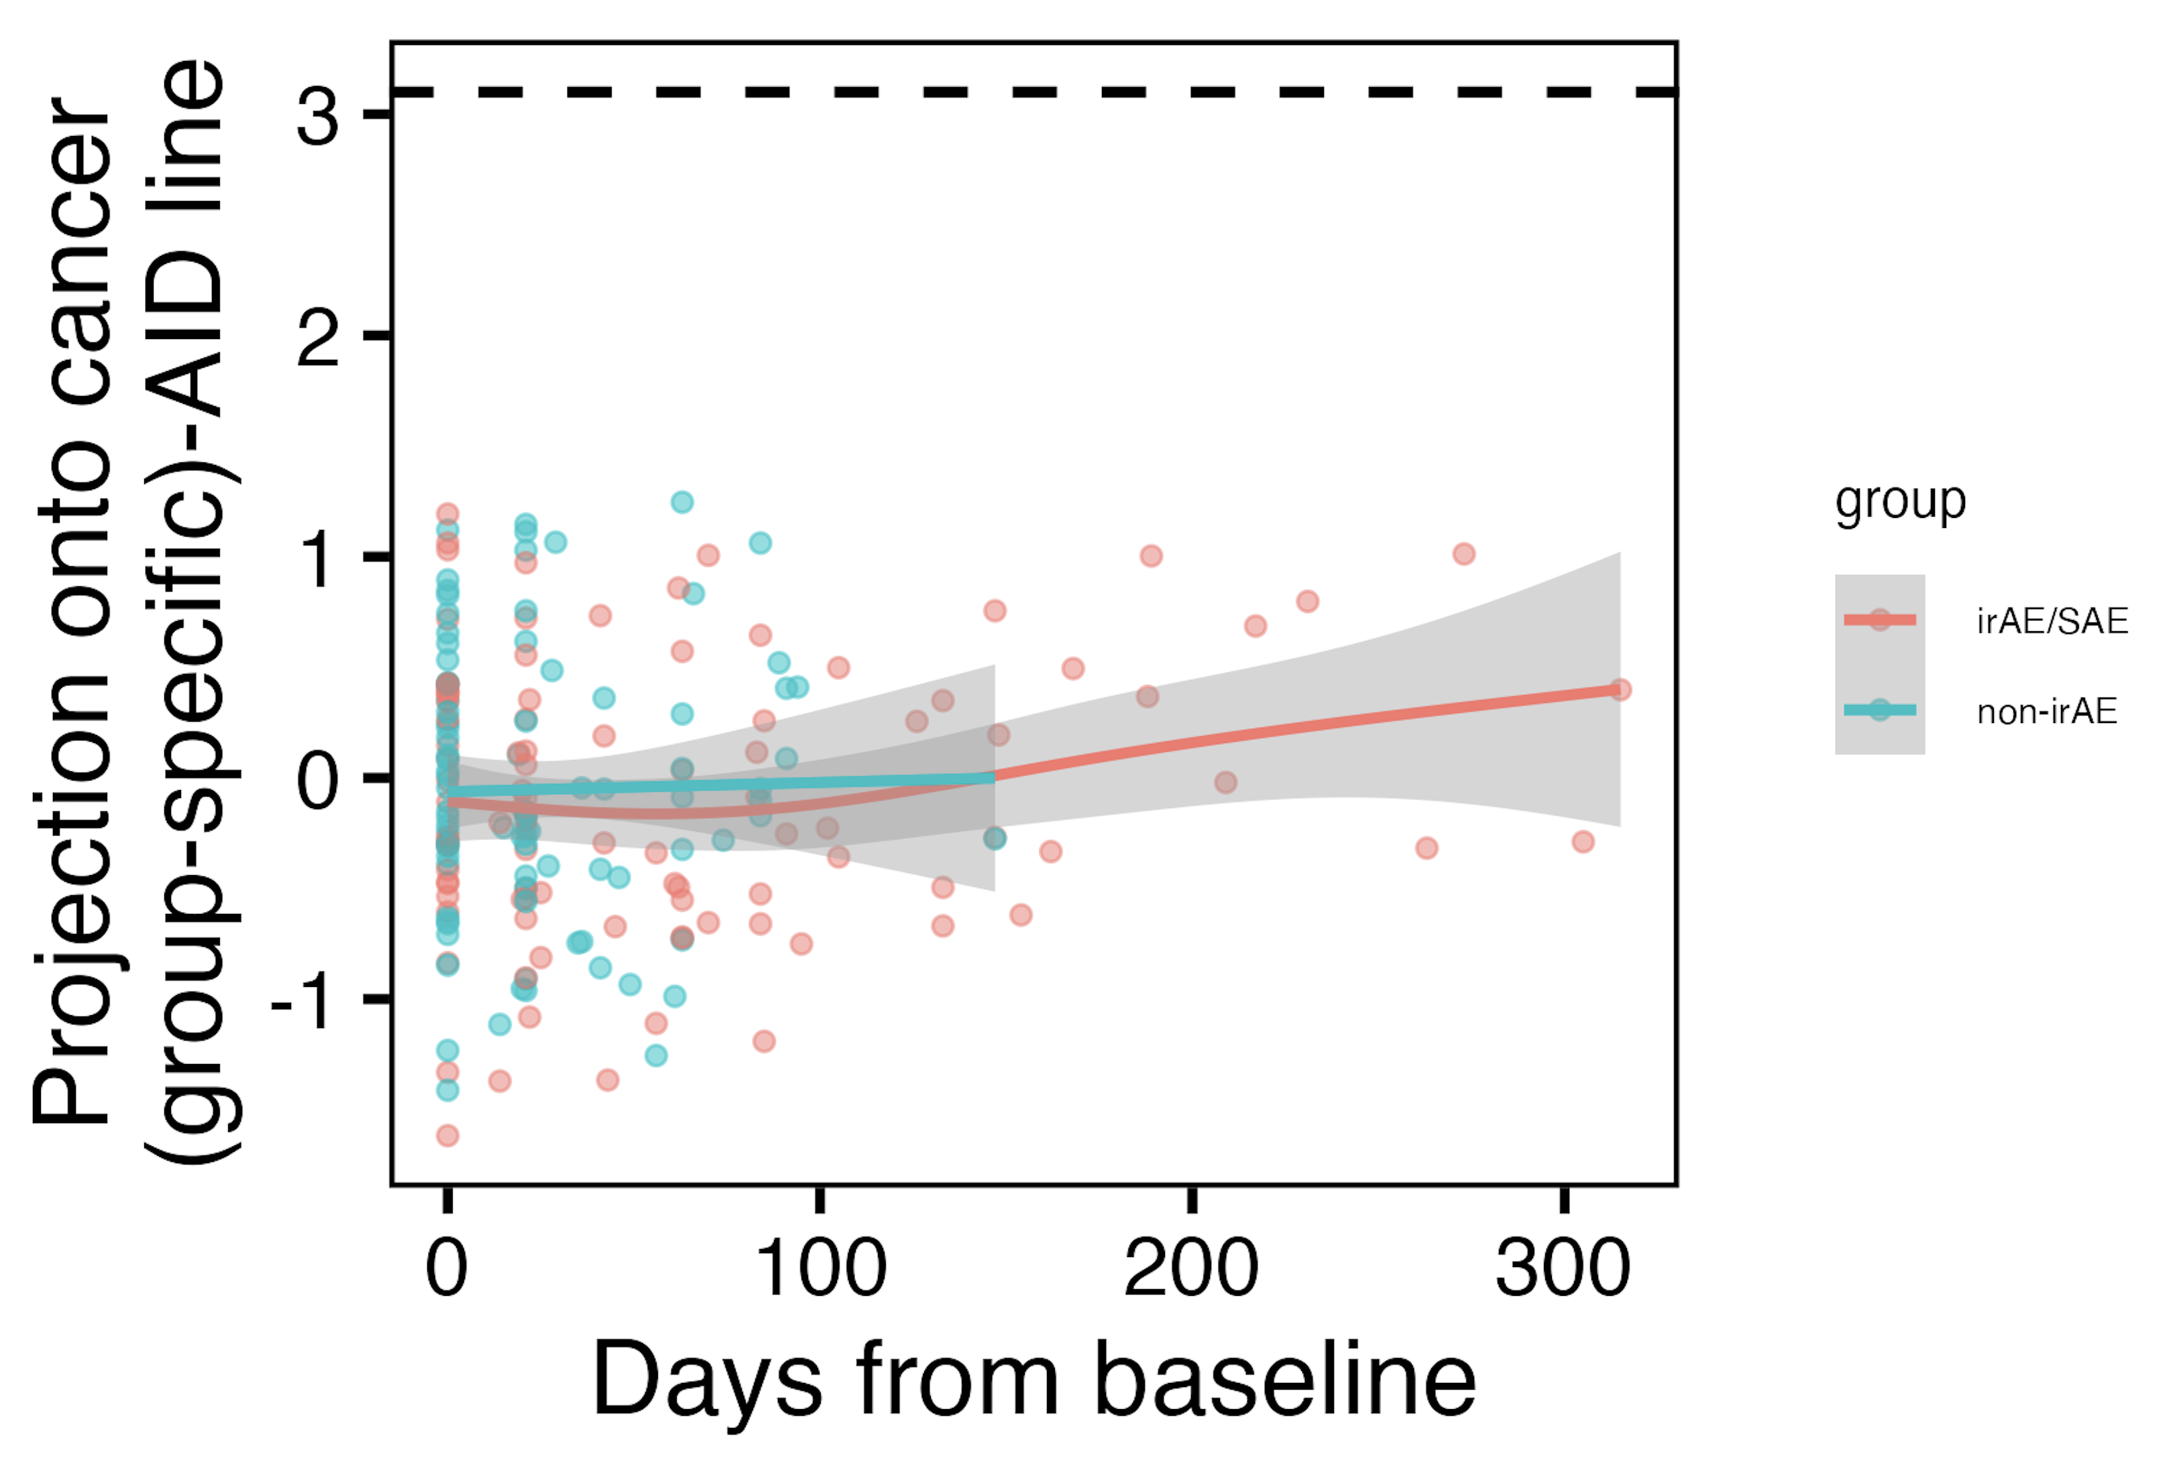
Immunotypes of irAE group do not seem to become more autoimmune-like at relevant timepoints
baseline cancer centroid-AID centroid distance
~*
padj < 0.1: ~*
Notes:
positive means closer to AID centroid
Caveat is that we don’t have data from non-irAE group out as long…

Slide 26
Summary
Some immune cell populations are more irAE-type-agnostic, others more specific
irAE development not associated with response
Thyroid irAEs are associated with increased frequencies of several T cell populations over ICI
Those with irAEs do not seem to develop a more autoimmune-like immunotype than those without irAEs in the time frame where most irAEs develop
Notes:
Also don’t see lvl1 automated gating T/B predicting irAE development

Slide 27
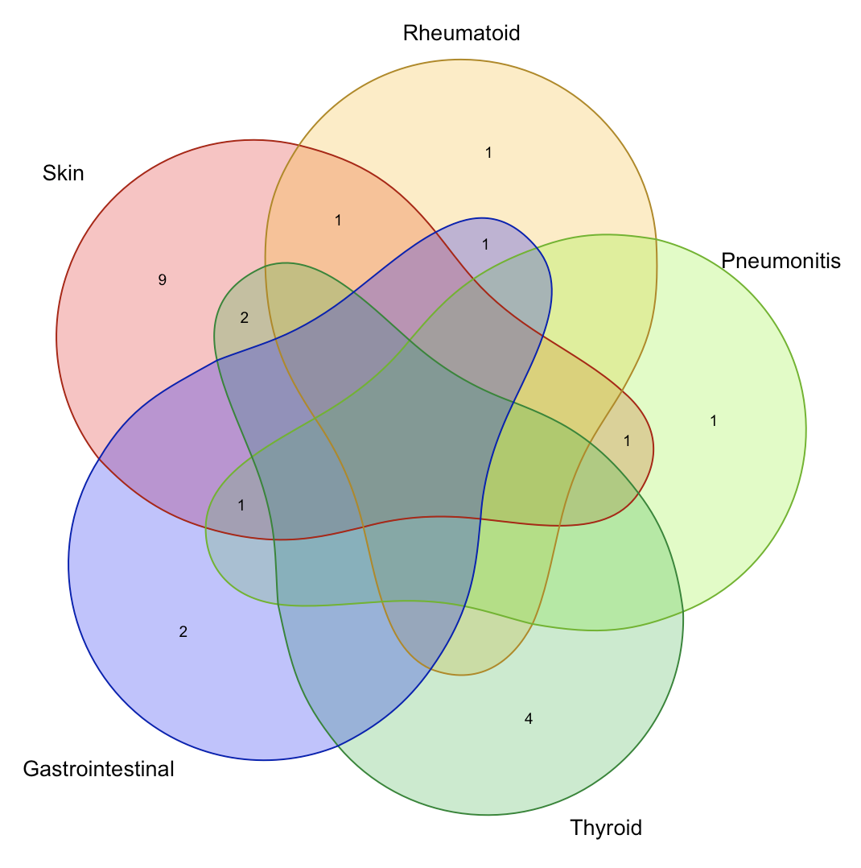
Proposed follow-up experiment: what’s driving specific irAEs vs. general ones
irAE type sharing
Motivation
Some immune cell populations seem more/less irAE type-specific
Baseline B cells frequency lower in (skin) irAE group
Thyroid irAEs associated with increased frequencies in several T cell populations over ICI
Question: what is the phenotype of T/B cells in those with thyroid, skin, vs. other irAEs?
Cohort
4 groups: only thyroid irAE, only skin irAE, other mixed irAE (non-skin/thyroid), no irAE
2 time points: baseline and visit 3
n = 4
Assay: bulk RNA of T, B cells separately sorted from PBMCs
Notes:
Financial considerations, but could also be cool to do just scRNAseq of PBMCs just at timepoint closest to irAE development (still 16 group-donor combos but just 1 timepoint then…)
if there are more than 4 with only thyroid irAE choose based on strongest changes in T cell freqs from baseline
If can only afford 1, would prefer RNA
Majority of irAEs develop by visit 3
Maybe less data on our end for anti-thyroid T cells because it’s more of a antibody-mediated effect (Osorio et al. (2016)), but that would conflict with our data here…

Slide 28
Next steps
Include response as term in longitudinal analysis GAMs
Automated gating (IMPACD)
Include response as term in models
Extend automated gating analyses past baseline of depth 1 for T/B cells
Notes:
Do see differences given that variability due to R/NR was being attributed to group maybe, soooo need to revamp before we pursue an experimental followup

Slide 29

Acknowledgements
Peter Linsley
Long lab/HIPcore
Alice Long, Alice Wiedeman
Holly Akilesh
Buckner lab
Jane Buckner, Sylvia Posso
Bernard Khor
Bioinformatics
Hannah DeBerg
Basilin Benson
Andrew Koval
Stephan Pribitzer
Clinical teams at VM, SCCA, & the University of Texas

Slide 30
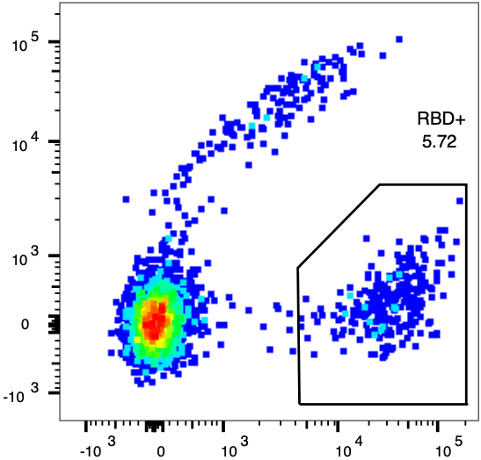
IMPACD analysis workflow
Manual gating
Validation
Gate markers of interest for each batch on a subset of data
Verify data is ready for automated gating
Decoy (PE-Cy7) →
IMPACD
High-performance automated gating gives counts-like object – similar to RNAseq alignment
RBD (PE) →
Analysis
Statistical analysis and more

Slide 31
Automated gating to various depths
T cells
Can quickly get to thousands of subsets per root path
CD19+
ICOS+
CD25+
depth 1
ICOS+
CD25+
CD19+
CD25+
CD19+
ICOS+
depth 2
CD25+
ICOS+
CD25+
CD16+
ICOS+
CD19+
depth 3

Slide 32
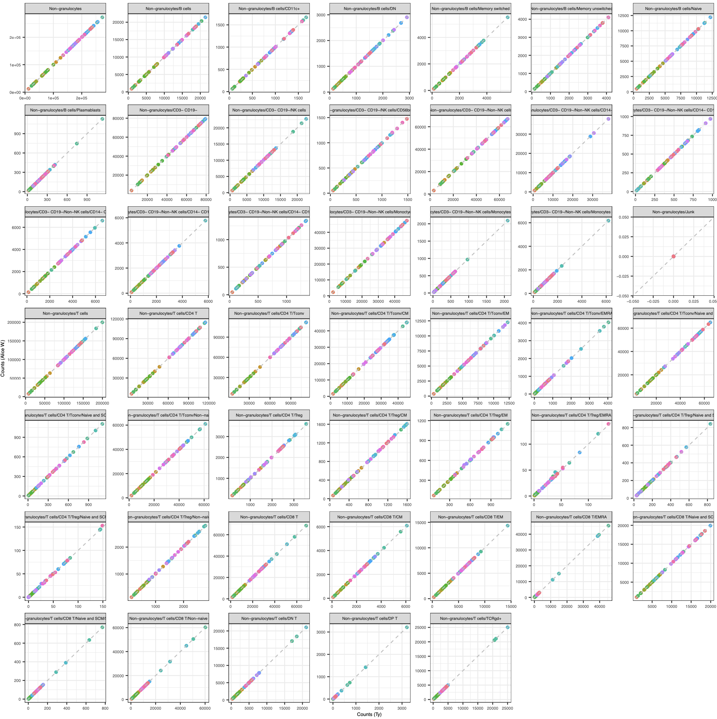
Validating automated gating
Verify IMPACD can extract
transformations
gate coordinates
batch specific effects
Compare counts for all samples
Essential for success of analysis

Slide 33
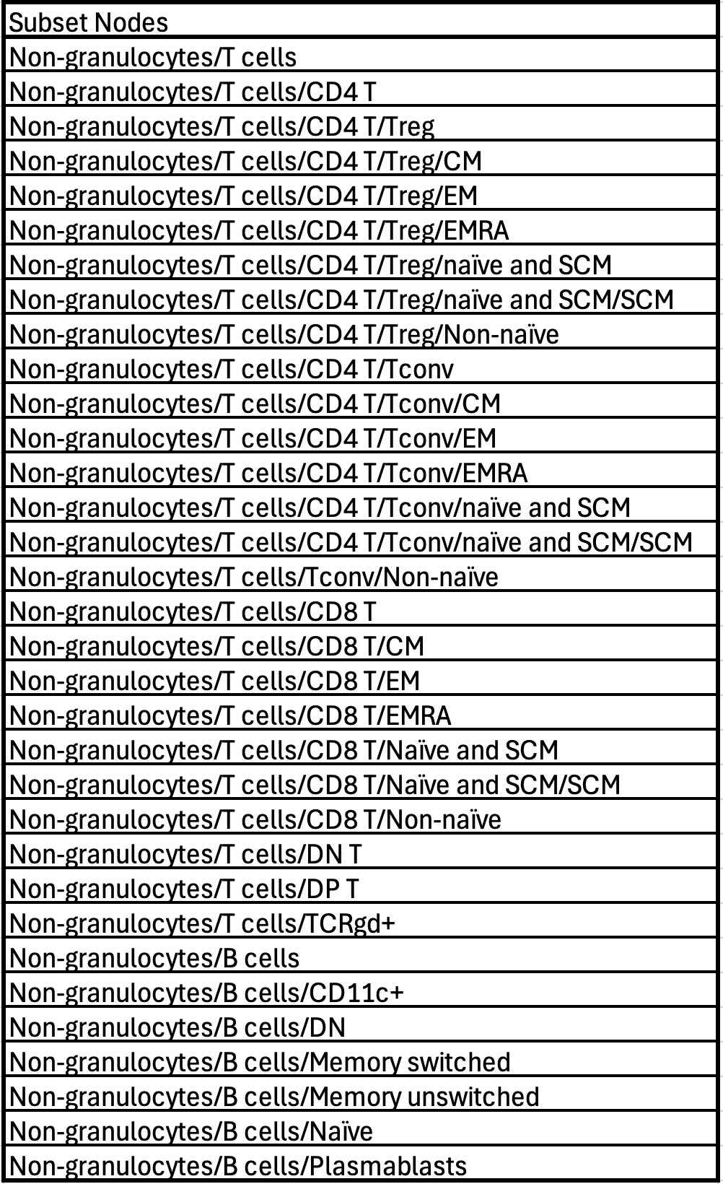
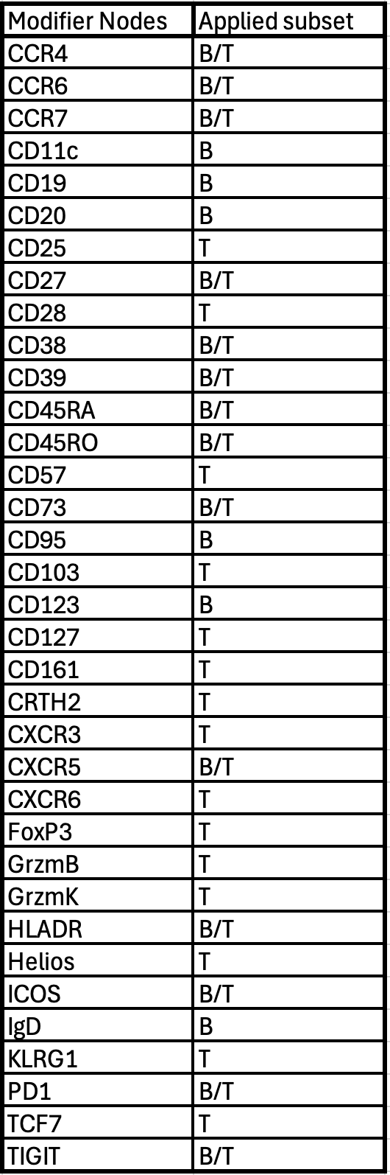
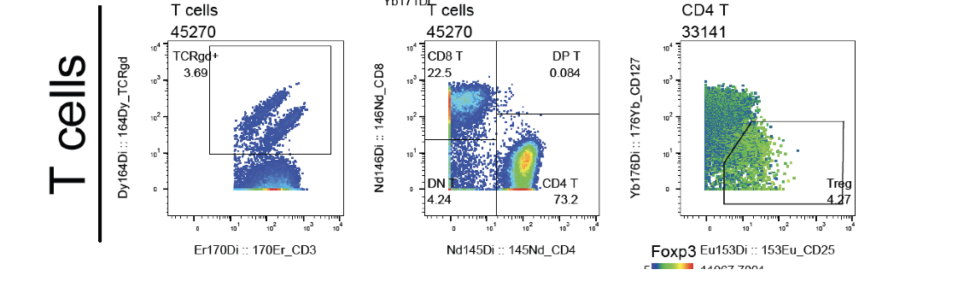
Automated gating: 1st pass subset & modifier nodes
Alice Wiedeman
Notes:
Generally aired on side of including modifier node if it might be relevant for subset

